Slide 1
Quantitative Risk Management: Lecture 2 – Monte Carlo VaR and Multivariate Distributions
Roy E. DeMeo, Jr.

Slide 2
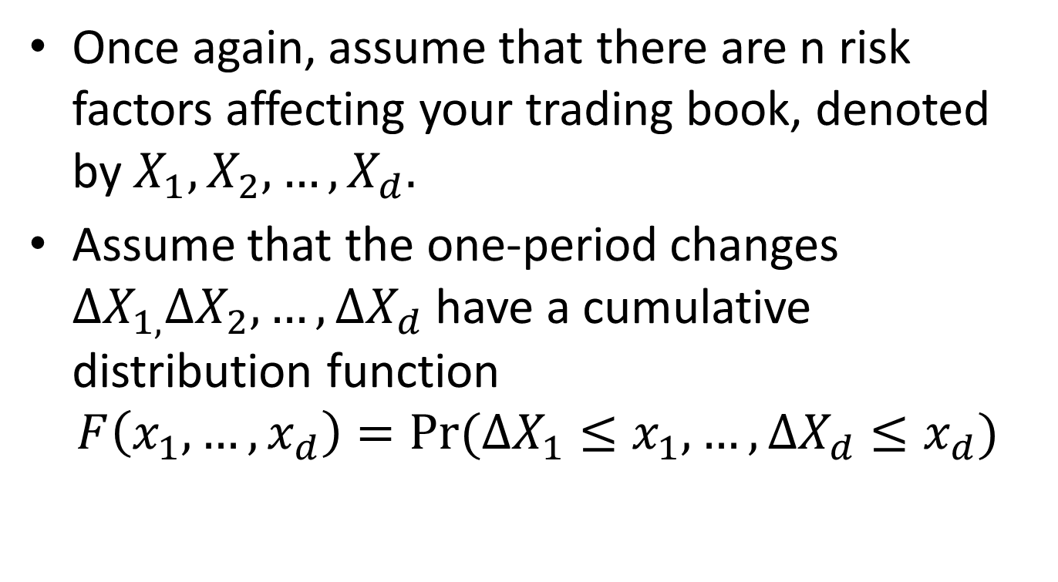
Monte Carlo VaR Model
Once again, assume that there are n risk factors affecting your trading book, denoted by $X_{1},X_{2},…,X_{d}.$
Assume that the one-period changes $∆X_{1,}∆X_{2},…,∆X_{d}$ have a cumulative distribution function
$$F\left(x_{1},…,x_{d}\right)=Pr⁡(∆X_{1}≤x_{1},…,∆X_{d}≤x_{d})$$

Slide 3
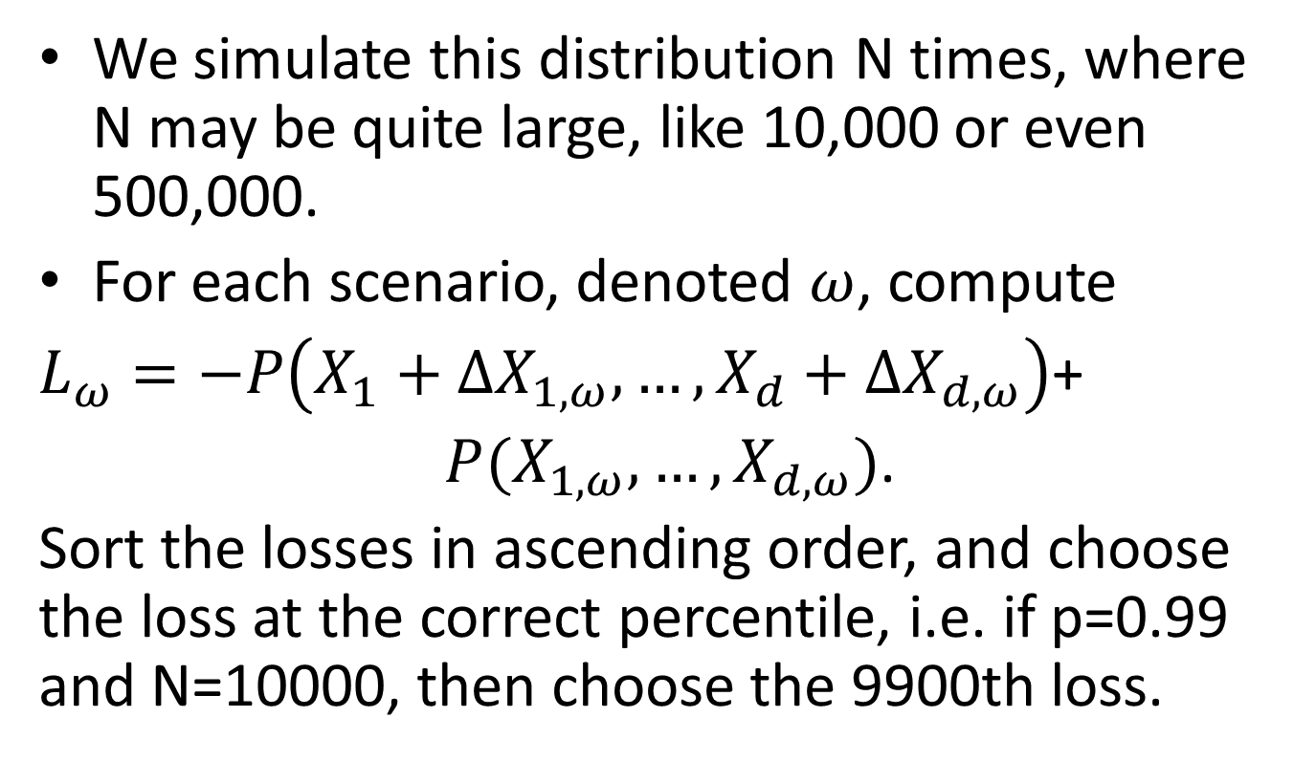
MC VaR, Continued
We simulate this distribution N times, where N may be quite large, like 10,000 or even 500,000.
For each scenario, denoted $ω$, compute
$L_{ω}=−P\left(X_{1}+∆X_{1,ω},…,X_{d}+∆X_{d,ω}\right)$+
$P(X_{1,ω},…,X_{d,ω})$.
Sort the losses in ascending order, and choose the loss at the correct percentile, i.e. if p=0.99 and N=10000, then choose the 9900th loss.

Slide 4
Advantages of MC vs Historical
2nd worst loss out of 251 days, or 7th worst loss out of 755 (3 years) is very crude even though the regulators allow it. 100th worst loss out of 10000 is much more precise.
More flexible framework – can more easily allow bias toward more recent data or toward more use of market data
Provides a framework for modeling more extreme events, such as when using p=0.999. Hence its use for Specific Risk and IRC.

Slide 5
Disadvantages of MC
Takes much longer to run, making full revaluation prohibitively expensive in most cases.
Much more work to create a sensible model for the one period changes of a large number of risk factors – historical simulation requires no modeling beyond choosing the risk factors.

Slide 6
MC vs Historical - Uses
Historical simulation can be appropriate for General VaR or Stressed VaR, and is acceptable to regulators in these contexts.
Monte Carlo simulations are necessary for Specific Risk, Incremental Risk Charge.

Slide 7
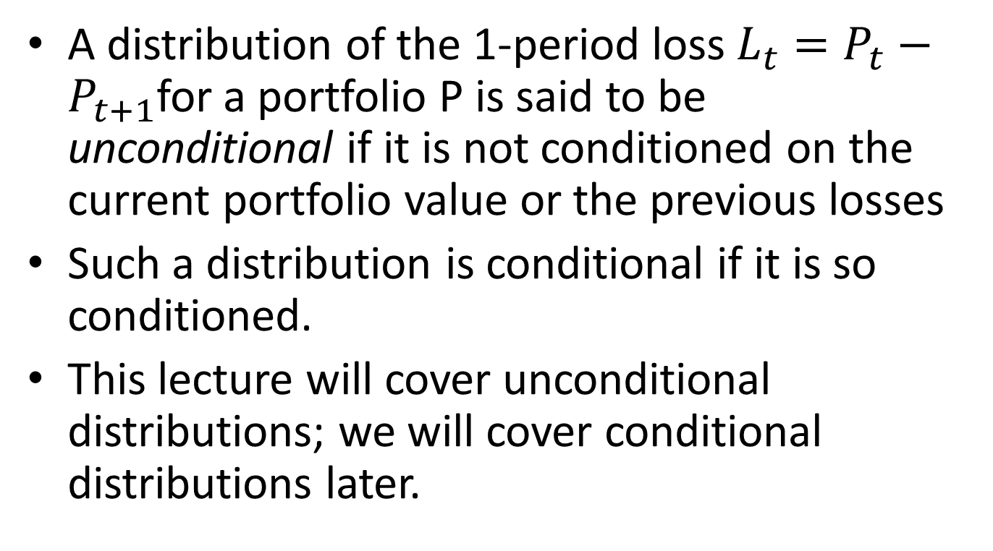
Conditional vs Unconditional VaR Models
A distribution of the 1-period loss $L_{t}=P_{t}−P_{t+1}$for a portfolio P is said to be unconditional if it is not conditioned on the current portfolio value or the previous losses
Such a distribution is conditional if it is so conditioned.
This lecture will cover unconditional distributions; we will cover conditional distributions later.

Slide 8
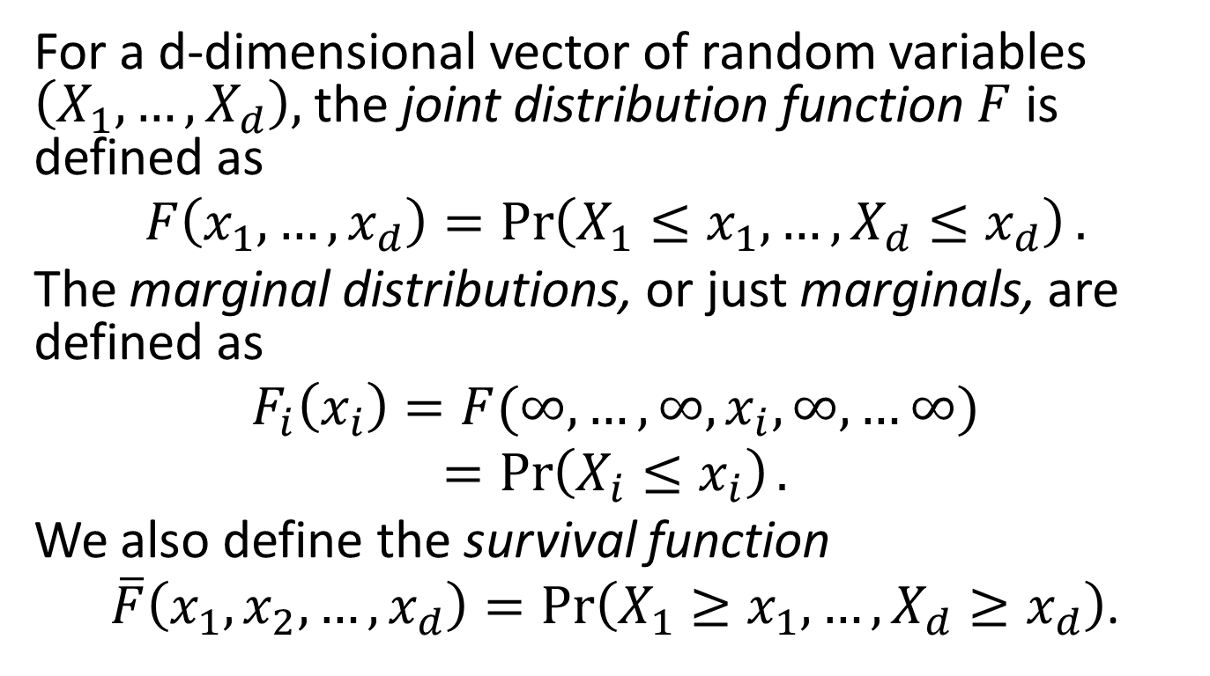
Multivariate Models – The Basics
For a d-dimensional vector of random variables $\left(X_{1},…,X_{d}\right),$ the joint distribution function $F$ is defined as
$$F\left(x_{1},…,x_{d}\right)=\operatorname{Pr}\left(X_{1}≤x_{1},…,X_{d}≤x_{d}\right).$$
The marginal distributions, or just marginals, are defined as
$$F_{i}\left(x_{i}\right)=F(∞,…,∞,x_{i},∞,…∞)$$
$$=\operatorname{Pr}\left(X_{i}≤x_{i}\right).$$
We also define the survival function
$\overline{F}\left(x_{1},x_{2},…,x_{d}\right)=\operatorname{Pr}\left(X_{1}≥x_{1},…,X_{d}≥x_{d}\right)$.

Slide 9
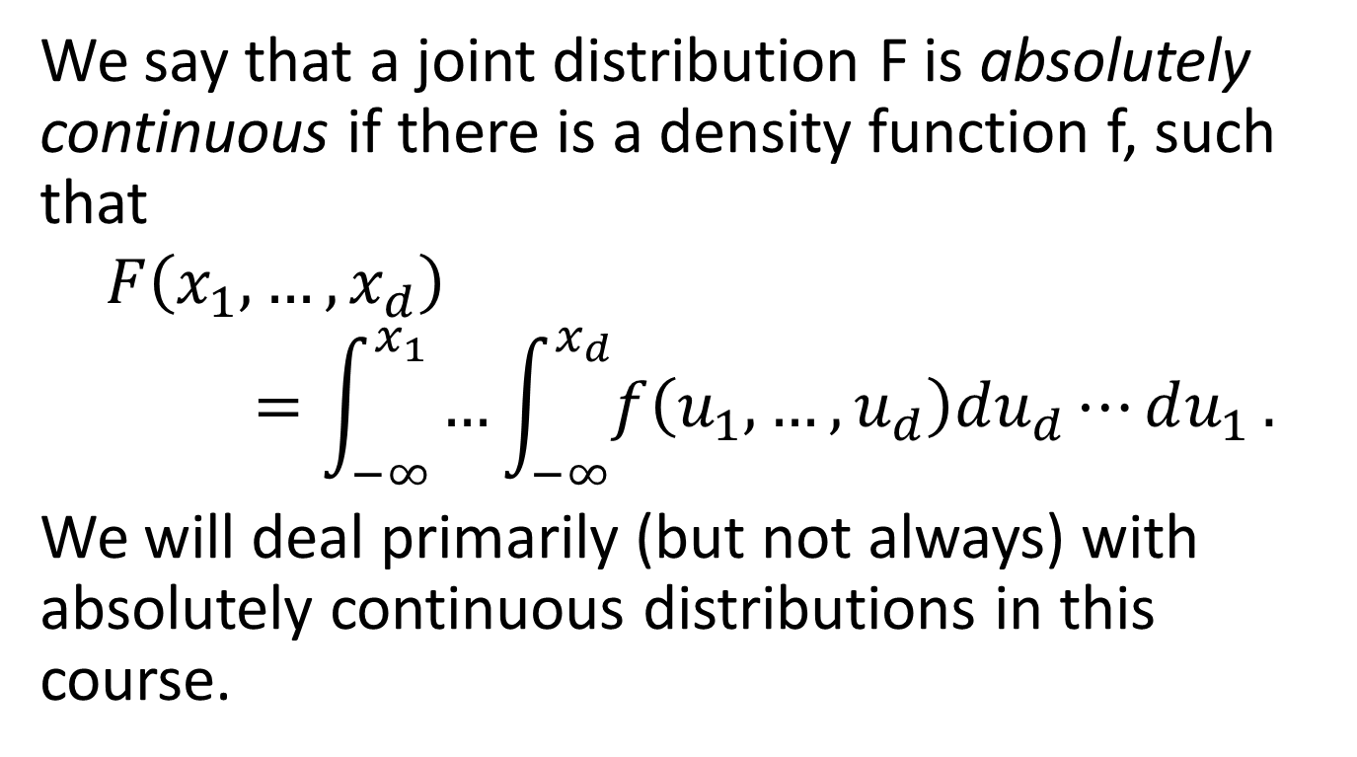
Multivariate Models, Cont’d
We say that a joint distribution F is absolutely continuous if there is a density function f, such that
$$F\left(x_{1},…,x_{d}\right)=\int_{−∞}^{x_{1}}{…\int_{−∞}^{x_{d}}{f\left(u_{1},…,u_{d}\right)du_{d}⋯du_{1}}}.$$
We will deal primarily (but not always) with absolutely continuous distributions in this course.

Slide 10
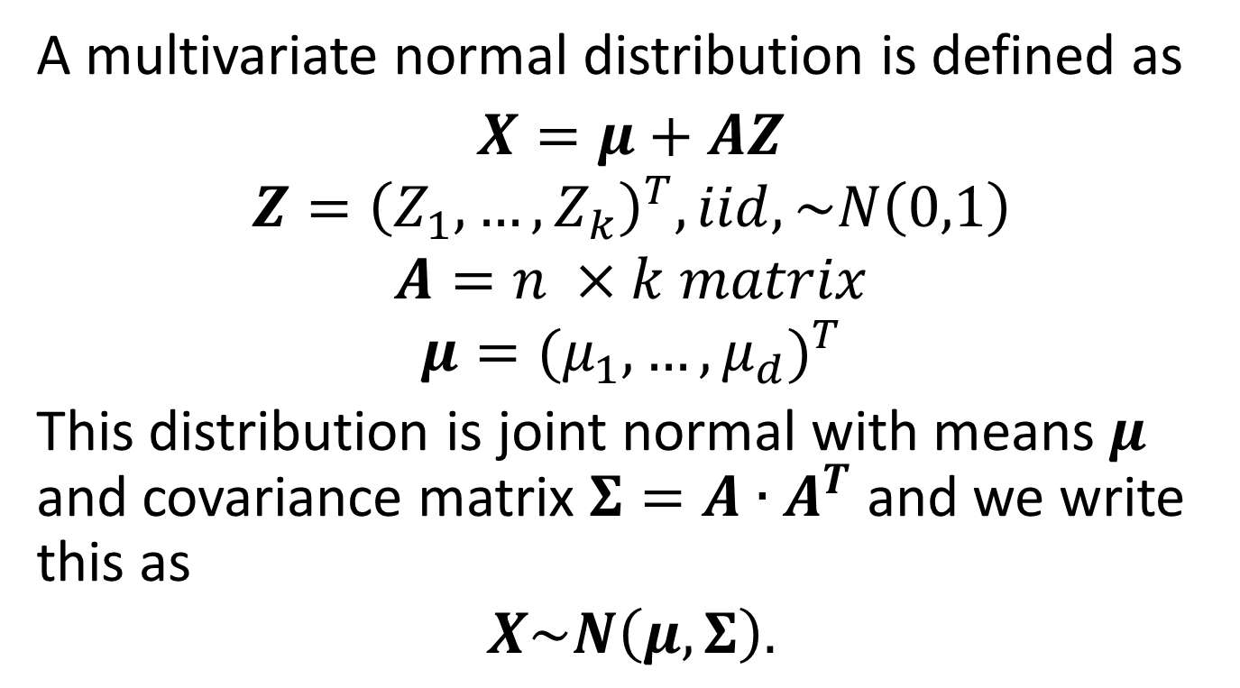
Multivariate Normal Distribution
A multivariate normal distribution is defined as
$X=μ+$ $AZ$
$$Z={\left(Z_{1},…,Z_{k}\right)}^{T}, iid, \sim N\left(0,1\right)$$
$$A=n ×k matrix$$
$$μ={(μ_{1},…,μ_{d})}^{T}$$
This distribution is joint normal with means $μ$ and covariance matrix $Σ=A∙A^{T}$ and we write this as
$$X\sim N\left(μ,Σ\right).$$

Slide 11
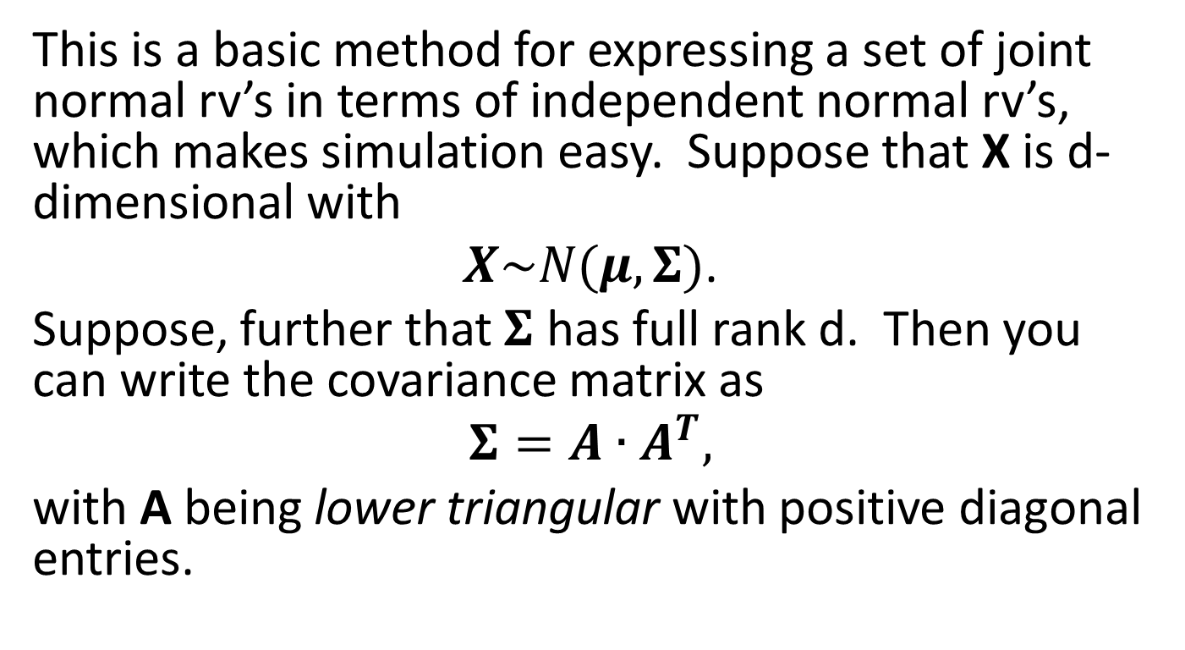
Cholesky Decomposition
This is a basic method for expressing a set of joint normal rv’s in terms of independent normal rv’s, which makes simulation easy. Suppose that X is d-dimensional with
$X\sim N(μ,Σ)$.
Suppose, further that $Σ$ has full rank d. Then you can write the covariance matrix as
$$Σ=A∙A^{T},$$
with A being lower triangular with positive diagonal entries.

Slide 12
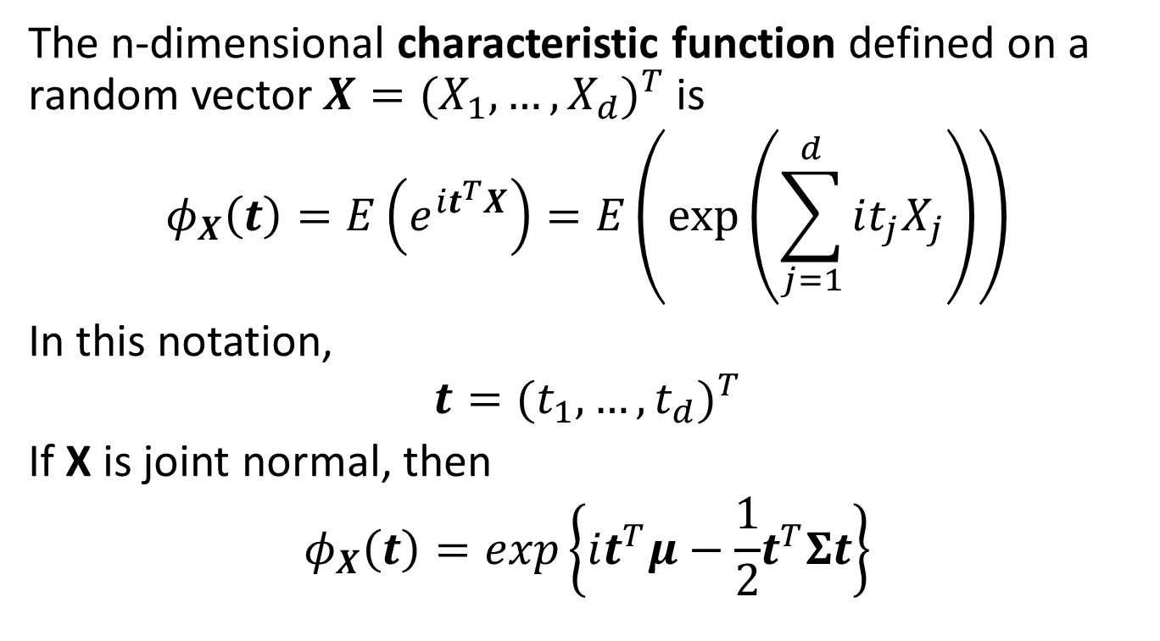
Characteristic Function
The n-dimensional characteristic function defined on a random vector $X={(X_{1},…,X_{d})}^{T}$ is
$$φ_{X}\left(t\right)=E\left(e^{it^{T}X}\right)=E\left(\exp\left(\sum_{j=1}^{d}{it_{j}X_{j}}\right)\right)$$
In this notation,
$$t={(t_{1},…,t_{d})}^{T}$$
If X is joint normal, then
$$φ_{X}\left(t\right)=exp\left\{it^{T}μ−\frac{1}{2}t^{T}Σt\right\}$$

Slide 13

Linear Combinations of Normals are Normal
Let $Y=BX+b.$ Then
$$X=μ+AZ$$
$$Y=B\left(μ+AZ\right)+b$$
$$Y=\left(Bμ+b\right)+BAZ$$

Slide 14
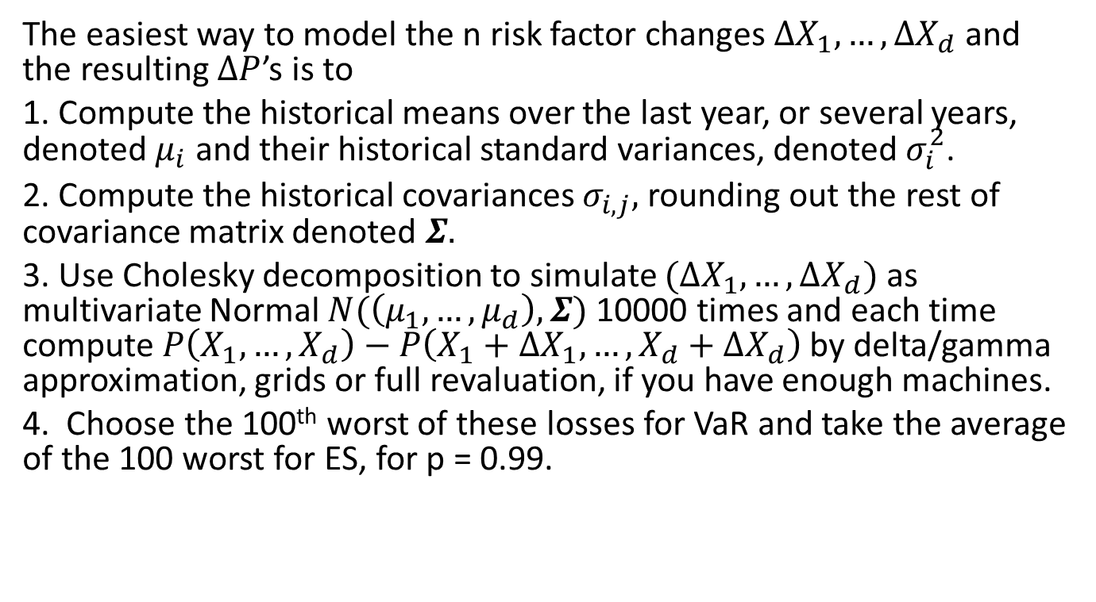
MC VaR Models for Beginners
The easiest way to model the n risk factor changes $∆X_{1},…,∆X_{d}$ and the resulting $∆P$’s is to
1. Compute the historical means over the last year, or several years, denoted $μ_{i}$ and their historical standard variances, denoted $σ_{i}^{2}$.
2. Compute the historical covariances $σ_{i,j},$rounding out the rest of covariance matrix denoted $Σ.$
3. Use Cholesky decomposition to simulate $(∆X_{1},…,∆X_{d})$ as multivariate Normal $N(\left(μ_{1},…,μ_{d}\right),Σ)$ 10000 times and each time compute $P\left(X_{1},…,X_{d}\right)−P\left(X_{1}+{ΔX}_{1},…,X_{d}+ΔX_{d}\right)$ by delta/gamma approximation, grids or full revaluation, if you have enough machines.
4. Choose the 100th worst of these losses for VaR and take the average of the 100 worst for ES, for p = 0.99.

Slide 15
Why This is Only for Beginners
Well, of course, the joint distribution of changes of n risk factors for a typical asset class would not be multivariate normal – they usually have fat tails – in other words the risk of an extreme move is far greater than what would be implied by a normal distribution. In fact, this “beginner” method would never pass muster with the regulators.
The next part of this class will cover multivariate distributions which might work better than normal.
After that we will show how to refine that further by using copulas.

Slide 16
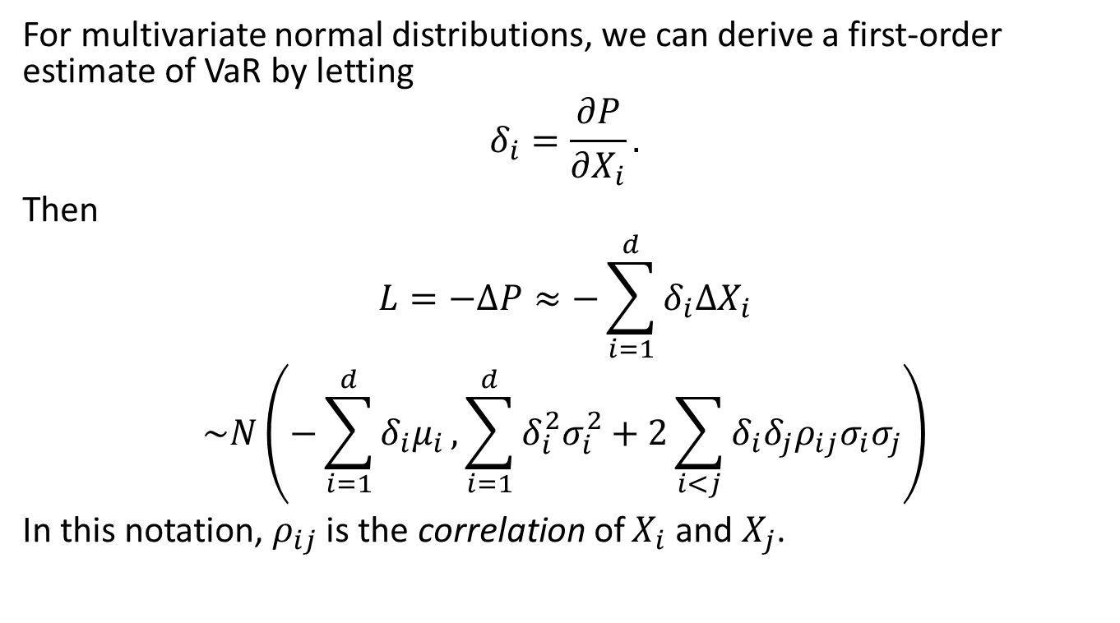
Variance-Covariance Estimate
For multivariate normal distributions, we can derive a first-order estimate of VaR by letting
$$δ_{i}=\frac{∂P}{∂X_{i}}.$$
Then
$$L=−∆P≈−\sum_{i=1}^{d}{δ_{i}∆X_{i}}$$
$$\sim N\left(−\sum_{i=1}^{d}{δ_{i}μ_{i}},\sum_{i=1}^{d}{δ_{i}^{2}σ_{i}^{2}}+2\sum_{i<j}{δ_{i}δ_{j}ρ_{ij}σ_{i}σ_{j}}\right)$$
In this notation, $ρ_{ij}$is the correlation of $X_{i}$and $X_{j}$.

Slide 17

Variance-Covariance, Cont’d
Writing this univariate normal distribution in shorthand as $N\left(\overline{μ},{\overline{σ}}^{2}\right),$ we see that
$$VaR\left(p\right)≈\overline{μ}+\overline{σ}N^{−1}\left(p\right).$$

Slide 18
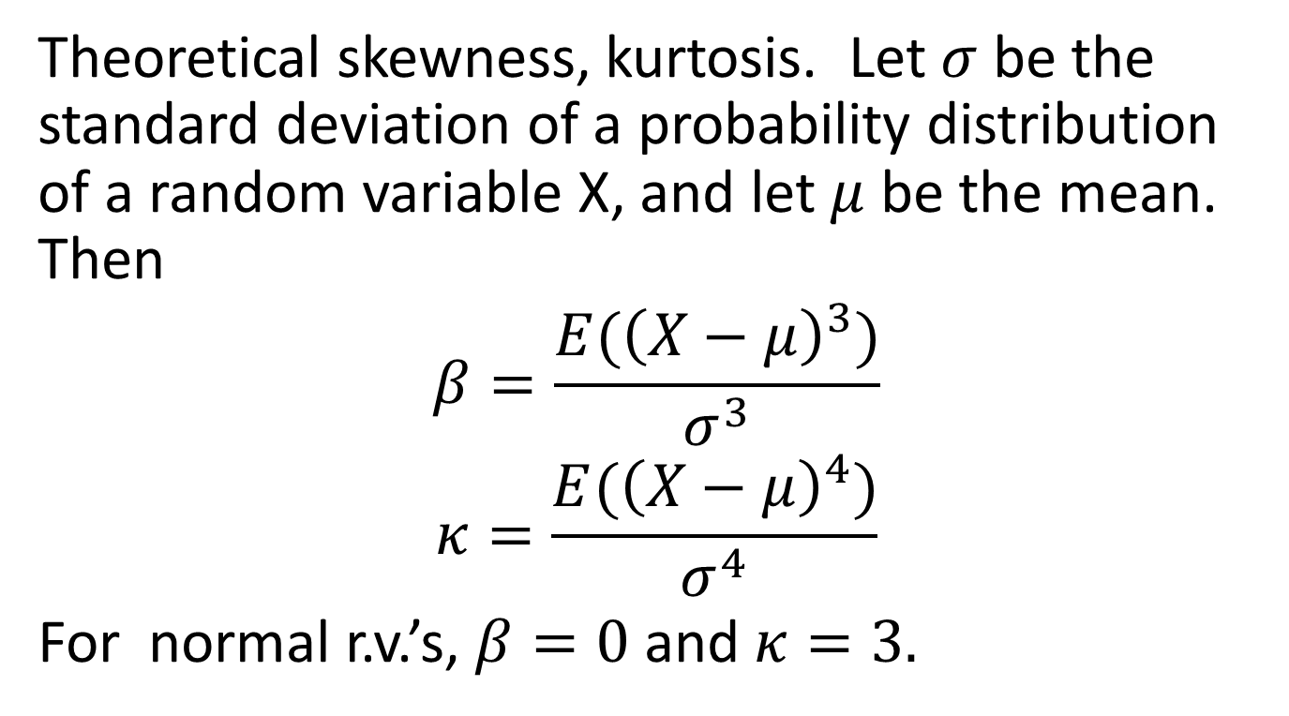
Some Basic Definitions – Skewness and Kurtosis
Theoretical skewness, kurtosis. Let $σ$ be the standard deviation of a probability distribution of a random variable X, and let $μ$ be the mean. Then
$$β=\frac{E({\left(X−μ\right)}^{3})}{σ^{3}}$$
$$κ=\frac{E({\left(X−μ\right)}^{4})}{σ^{4}}$$
For normal r.v.’s, $β=0$ and $κ=3.$

Slide 19
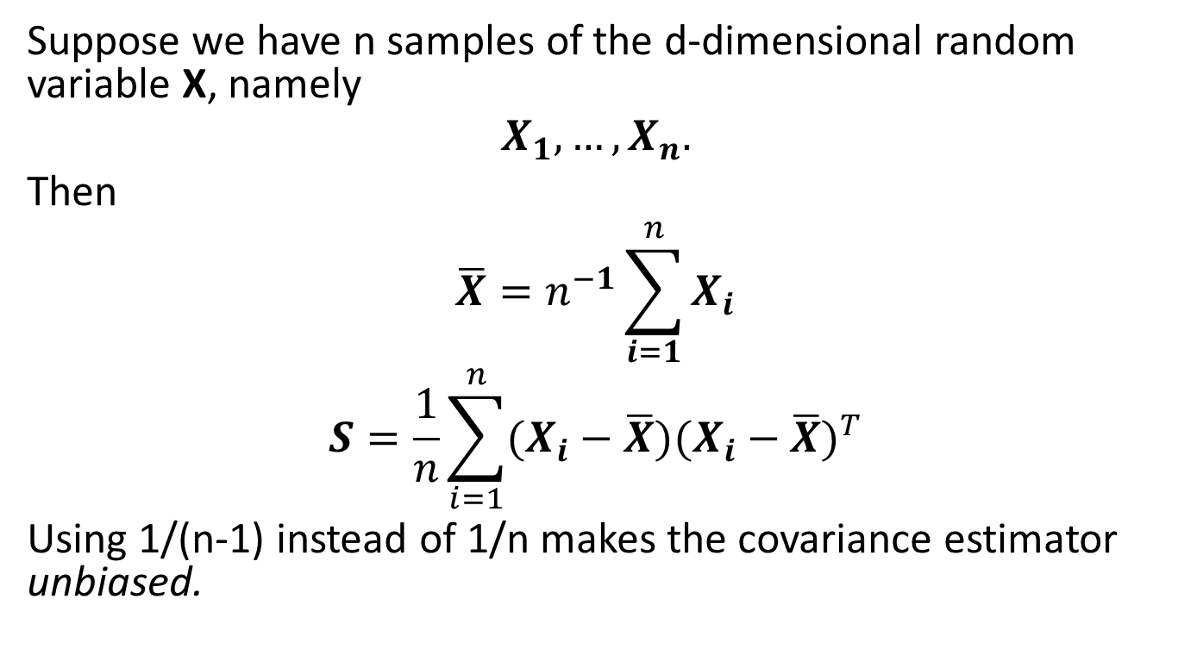
Sample Means and Covariance Matrix
Suppose we have n samples of the d-dimensional random variable X, namely
$$X_{1},…,X_{n}.$$
Then
$$\overline{X}=n^{−1}\sum_{i=1}^{n}{X_{i}}$$
$$S=\frac{1}{n}\sum_{i=1}^{n}{(X_{i}−\overline{X}){(X_{i}−\overline{X})}^{T}}$$
Using 1/(n-1) instead of 1/n makes the covariance estimator unbiased.

Slide 20
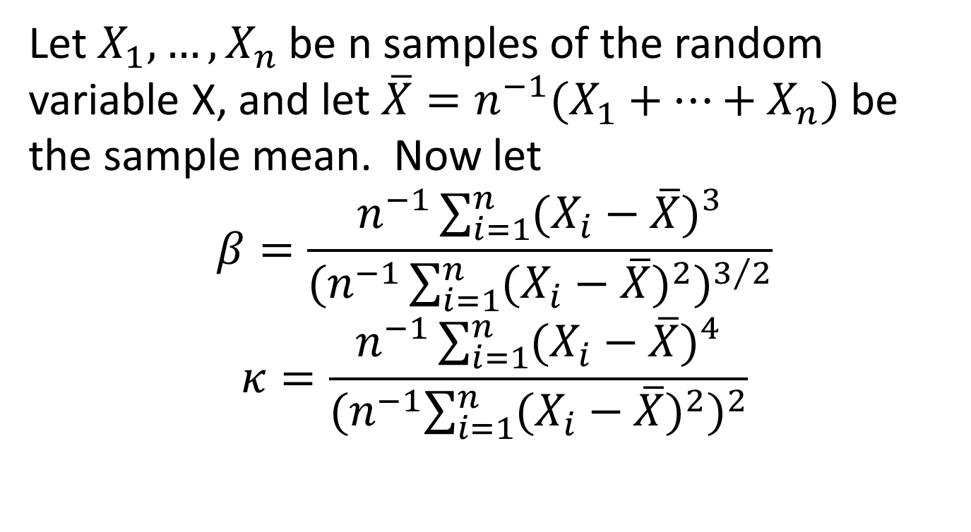
Sample Skewness and Kurtosis
Let $X_{1},…,X_{n}$be n samples of the random variable X, and let $\overline{X}=n^{−1}(X_{1}+…+X_{n})$ be the sample mean. Now let
$$β=\frac{n^{−1}\sum_{i=1}^{n}{{(X_{i}−\overline{X})}^{3}}}{{(n^{−1}\sum_{i=1}^{n}{{(X_{i}−\overline{X})}^{2}})}^{3/2}}$$
$$κ=\frac{n^{−1}\sum_{i=1}^{n}{{(X_{i}−\overline{X})}^{4}}}{{{(n}^{−1}\sum_{i=1}^{n}{{(X_{i}−\overline{X})}^{2}})}^{2}}$$

Slide 21
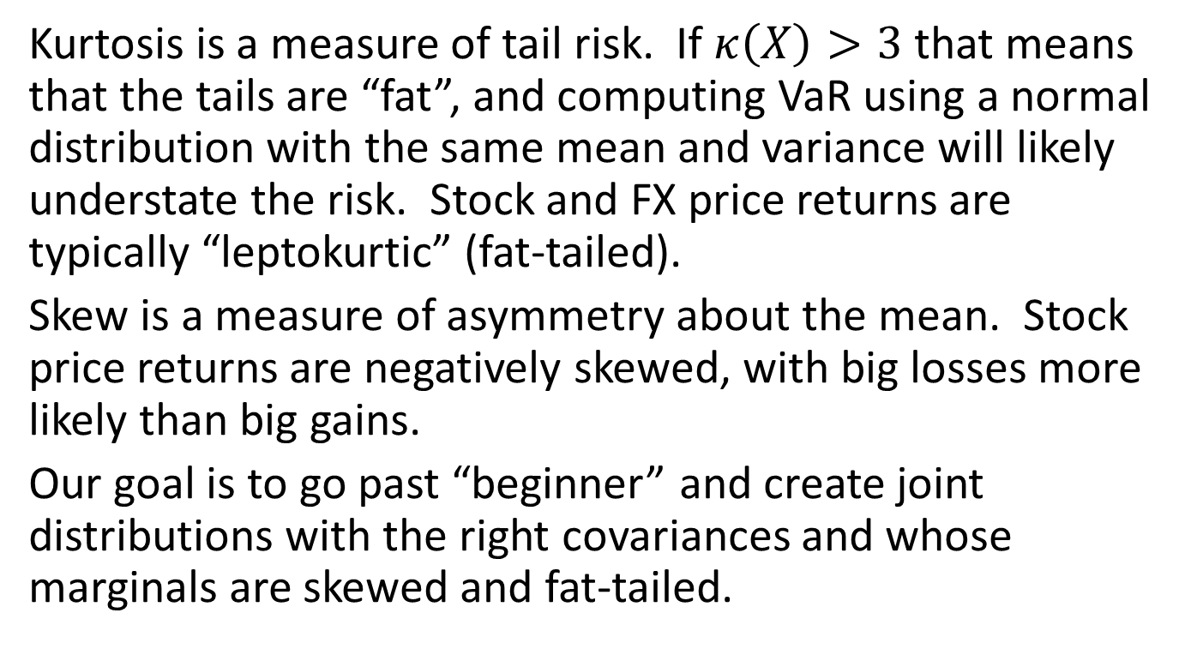
Why do Skewness and Kurtosis Matter?
Kurtosis is a measure of tail risk. If $κ\left(X\right)>3$ that means that the tails are “fat”, and computing VaR using a normal distribution with the same mean and variance will likely understate the risk. Stock and FX price returns are typically “leptokurtic” (fat-tailed).
Skew is a measure of asymmetry about the mean. Stock price returns are negatively skewed, with big losses more likely than big gains.
Our goal is to go past “beginner” and create joint distributions with the right covariances and whose marginals are skewed and fat-tailed.

Slide 22
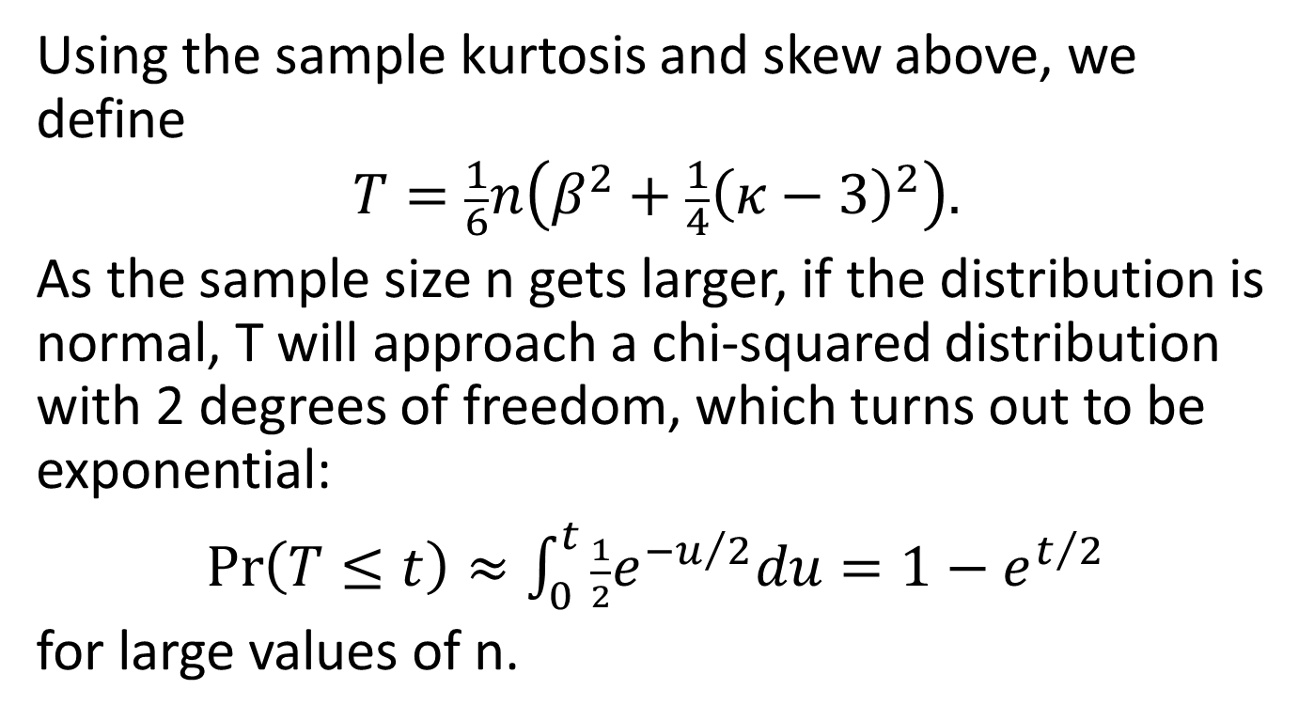
Test for Normality – Jarque-Bera
Using the sample kurtosis and skew above, we define
$$T=\frac{1}{6}n\left(β^{2}+\frac{1}{4}{\left(κ−3\right)}^{2}\right).$$
As the sample size n gets larger, if the distribution is normal, T will approach a chi-squared distribution with 2 degrees of freedom, which turns out to be exponential:
$\operatorname{Pr}\left(T≤t\right)≈\int_{0}^{t}{\frac{1}{2}e^{−u/2}du}=1−e^{t/2}$
for large values of n.

Slide 23
Daily and Weekly Stock Returns – Not Normal
 | daily returns, n=2020
 | stock | sample skew | sample kurtosis | JB Statistic | Pr(T > JB)
 | AXP | 0.05 | 5.09 | 368.49 | 9.62E-81
 | EK | -1.95 | 31.20 | 68,212.88 | 0
 | BA | 0.54 | 10.89 | 5,337.72 | 0
 | C | 0.21 | 5.95 | 747.31 | 5.30E-163
 | KO | -0.02 | 6.36 | 950.34 | 4.32E-207
 | MSFT | -0.22 | 8.04 | 2,154.26 | 0
 | HWP | -0.23 | 6.69 | 1,163.83 | 1.89E-253
 | INTC | -0.56 | 8.29 | 2,460.91 | 0
 | JPM | 0.14 | 5.25 | 432.69 | 1.10E-94
 | DIS | -0.01 | 9.39 | 3,436.74 | 0
 | weekly returns, n=416
 | AXP | -0.01 | 3.91 | 14.36 | 7.61E-04
 | EK | -1.13 | 14.40 | 2,341.17 | 0
 | BA | -0.26 | 7.54 | 361.95 | 2.53E-79
 | C | 0.44 | 5.42 | 114.93 | 1.10E-25
 | KO | -0.21 | 4.37 | 35.59 | 1.87E-08
 | MSFT | -0.14 | 5.25 | 89.11 | 4.47E-20
 | HWP | -0.26 | 4.66 | 52.45 | 4.08E-12
 | INTC | -0.65 | 5.20 | 113.19 | 2.64E-25
 | JPM | -0.20 | 4.93 | 67.34 | 2.39E-15
 | DIS | 0.08 | 4.48 | 38.41 | 4.56E-09

Slide 24
Monthly Returns – Mostly Not Normal
 | monthly returns, n=96
 | stock | sample skew | sample kurtosis | JB Statistic | Pr(T > JB)
 | AXP | -1.22 | 5.99 | 59.57 | 1.16E-13
 | EK | -1.52 | 10.37 | 254.23 | 6.22E-56
 | BA | -0.50 | 4.15 | 9.29 | 0.01
 | C | -1.10 | 7.38 | 96.10 | 1.36E-21
 | KO | -0.49 | 3.68 | 5.69 | 0.06
 | MSFT | -0.40 | 3.90 | 5.80 | 0.06
 | HWP | -0.33 | 3.47 | 2.63 | 0.27
 | INTC | -1.04 | 6.50 | 66.31 | 4.00E-15
 | JPM | -0.51 | 5.40 | 27.20 | 1.24E-06
 | DIS | 0.04 | 3.26 | 0.30 | 0.86

Slide 25
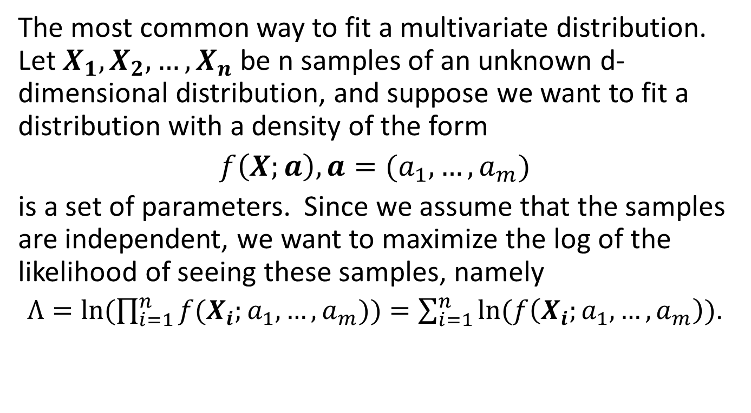
Maximum Log Likelihood
The most common way to fit a multivariate distribution. Let $X_{1},X_{2},…,X_{n}$ be n samples of an unknown d-dimensional distribution, and suppose we want to fit a distribution with a density of the form
$f\left(X;a\right),a=(a_{1},…,a_{m})$
is a set of parameters. Since we assume that the samples are independent, we want to maximize the log of the likelihood of seeing these samples, namely
$Λ=ln⁡(\prod_{i=1}^{n}{f(X_{i};a_{1},…,a_{m}))}=\sum_{i=1}^{n}{ln⁡(f\left(X_{i};a_{1},…,a_{m}\right))}$.

Slide 26
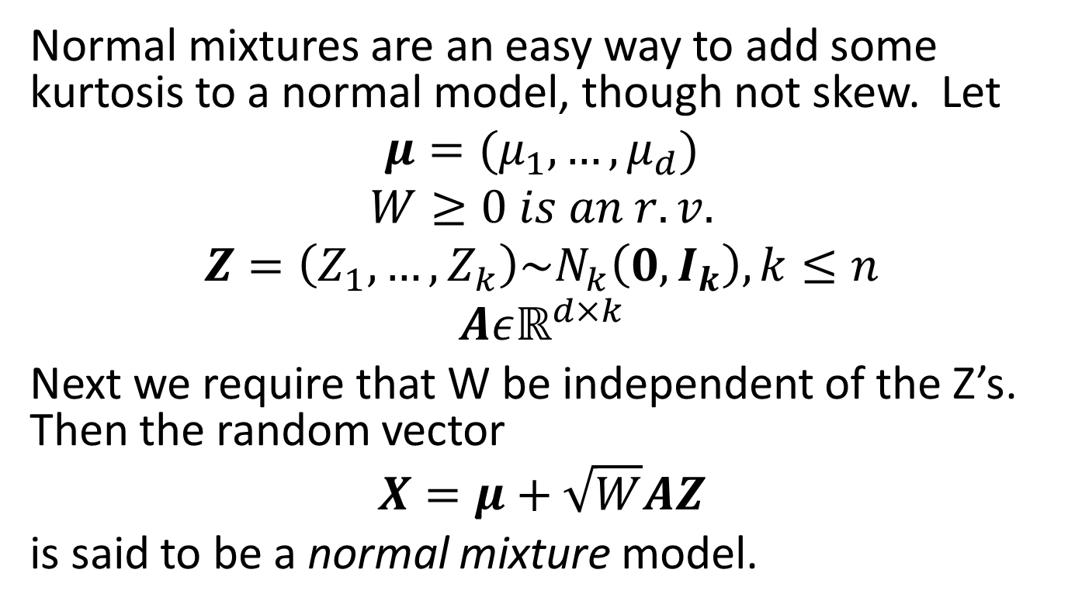
Normal Mixture Models
Normal mixtures are an easy way to add some kurtosis to a normal model, though not skew. Let
$$μ=(μ_{1},…,μ_{d})$$
$$W≥0 is an r.v.$$
$$Z=\left(Z_{1},…,Z_{k}\right)\sim N_{k}\left(0,I_{k}\right), k≤n$$
$$Aεℝ^{d×k}$$
Next we require that W be independent of the Z’s. Then the random vector
$$X=μ+\sqrt{W}AZ$$
is said to be a normal mixture model.

Slide 27
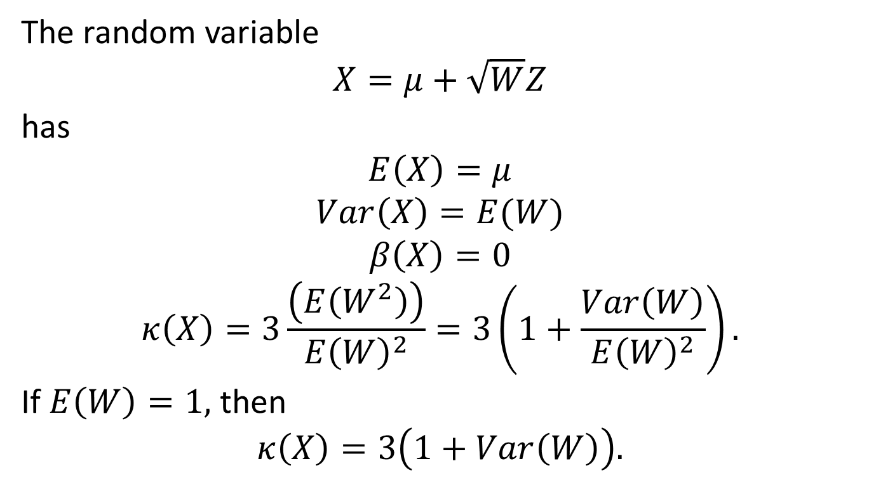
Simple 1-D Example
The random variable
$$X=μ+\sqrt{W}Z$$
has
$$E\left(X\right)=μ$$
$$Var\left(X\right)=E(W)$$
$$β\left(X\right)=0$$
$$κ\left(X\right)=3\frac{\left(E\left(W^{2}\right)\right)}{E{\left(W\right)}^{2}}=3\left(1+\frac{Var\left(W\right)}{E{\left(W\right)}^{2}}\right).$$
If $E\left(W\right)=1,$ then
$$κ\left(X\right)=3\left(1+Var\left(W\right)\right).$$

Slide 28
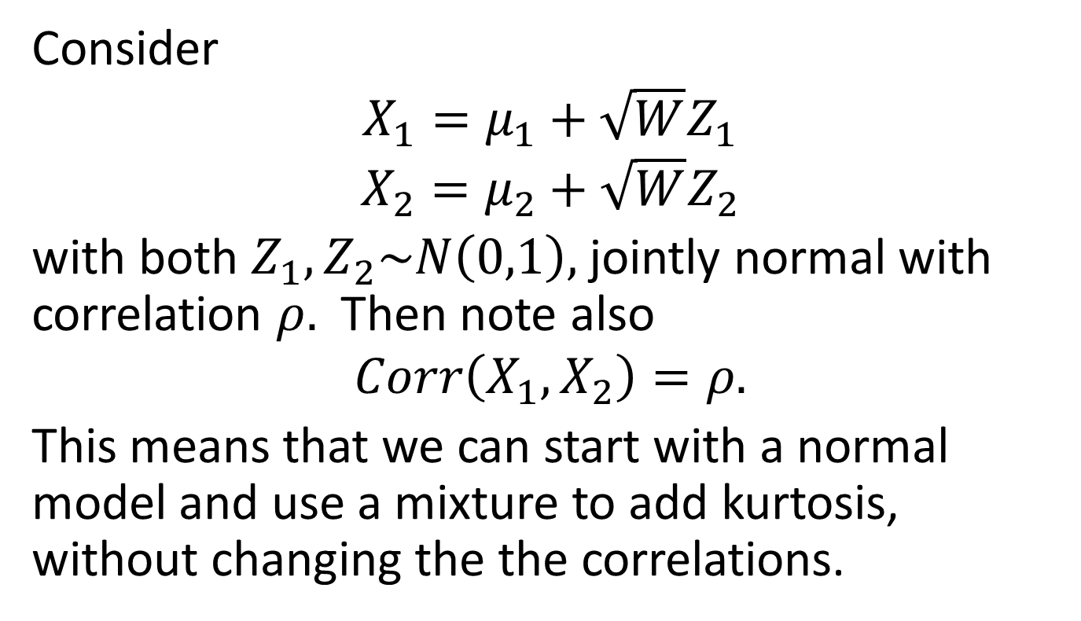
A 2-D Example
Consider
$$X_{1}=μ_{1}+\sqrt{W}Z_{1}$$
$$X_{2}=μ_{2}+\sqrt{W}Z_{2}$$
with both $Z_{1},Z_{2}\sim N\left(0,1\right),$ jointly normal with correlation $ρ.$ Then note also
$$Corr\left(X_{1},X_{2}\right)=ρ.$$
This means that we can start with a normal model and use a mixture to add kurtosis, without changing the the correlations.

Slide 29
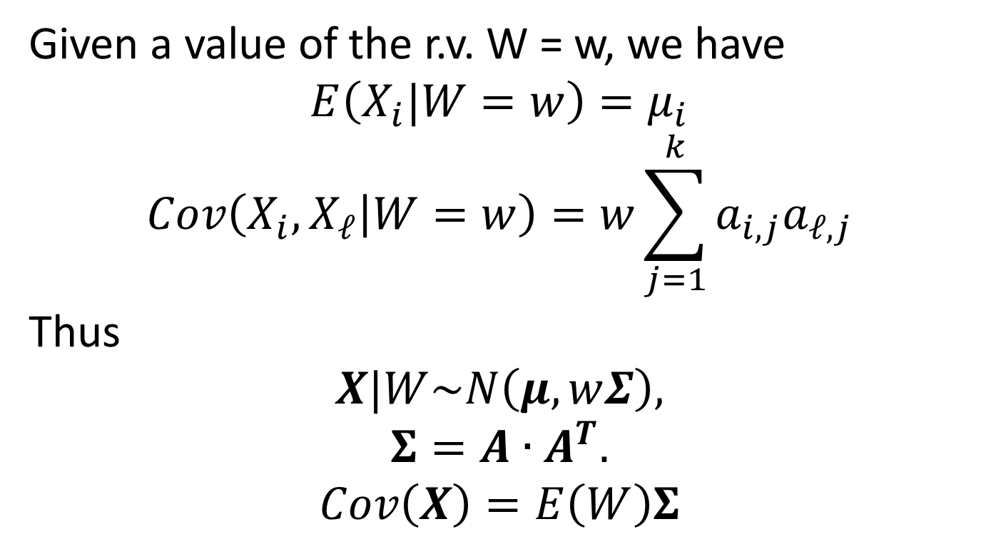
More About Normal Mixtures
Given a value of the r.v. W = w, we have
$$E\left(X_{i}|W=w\right)=μ_{i}$$
$$Cov\left(X_{i},X_{ℓ} | W=w\right)=w\sum_{j=1}^{k}{a_{i,j}a_{ℓ,j}}$$
Thus
$$X|W\sim N\left(μ,wΣ\right),$$
$$Σ=A∙A^{T}.$$
$$Cov\left(X\right)=E\left(W\right)Σ$$

Slide 30
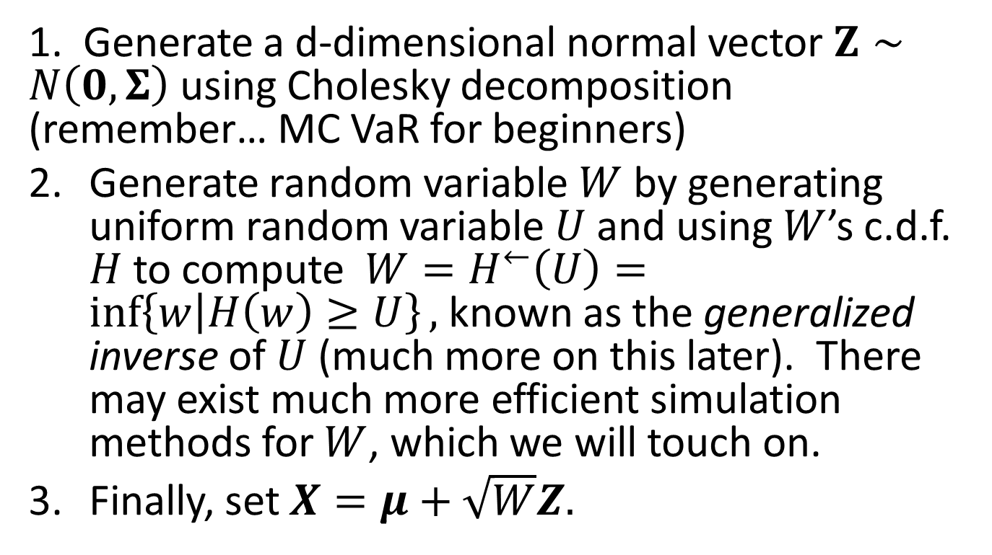
How to Simulate a Normal Mixture
1. Generate a d-dimensional normal vector $Z∼N\left(0,Σ\right)$ using Cholesky decomposition (remember… MC VaR for beginners)
Generate random variable $W$ by generating uniform random variable $U$and using $W$’s c.d.f. $H$ to compute $W=H^{←}\left(U\right)=\inf\left\{w | H\left(w\right)≥U\right\},$ known as the generalized inverse of $U$(much more on this later). There may exist much more efficient simulation methods for $W$, which we will touch on.
Finally, set $X=μ+\sqrt{W}Z.$

Slide 31
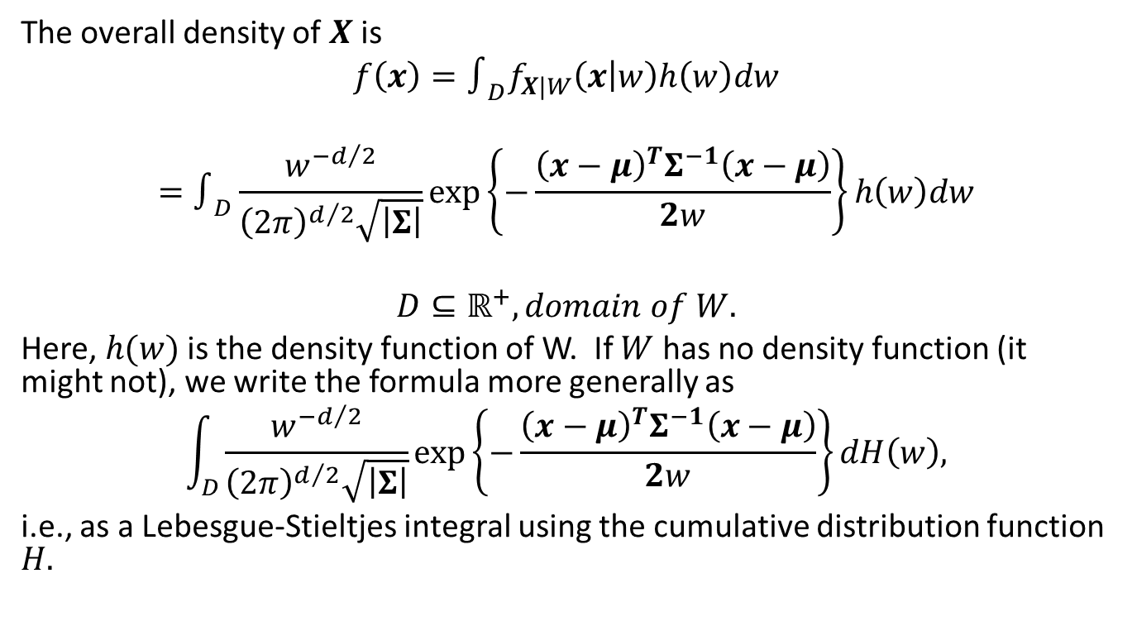
Normal Mixture Density
The overall density of $X$ is
$$f\left(x\right)=∫_{D}f_{X|W}\left(x | w\right)h\left(w\right)dw$$
$$=∫_{D}\frac{w^{{−d}/2}}{{\left(2π\right)}^{d/2}\sqrt{\left|Σ\right|}}\exp\left\{−\frac{{\left(x−μ\right)}^{T}Σ^{−1}\left(x−μ\right)}{2w}\right\}h\left(w\right)dw$$
$$D⊆ℝ^{+}, domain of W.$$
Here, $h(w)$ is the density function of W. If $W$ has no density function (it might not), we write the formula more generally as
$$\int_{D}{\frac{w^{{−d}/2}}{{\left(2π\right)}^{d/2}\sqrt{\left|Σ\right|}}\exp\left\{−\frac{{\left(x−μ\right)}^{T}Σ^{−1}\left(x−μ\right)}{2w}\right\}dH\left(w\right),}$$
i.e., as a Lebesgue-Stieltjes integral using the cumulative distribution function $H.$

Slide 32
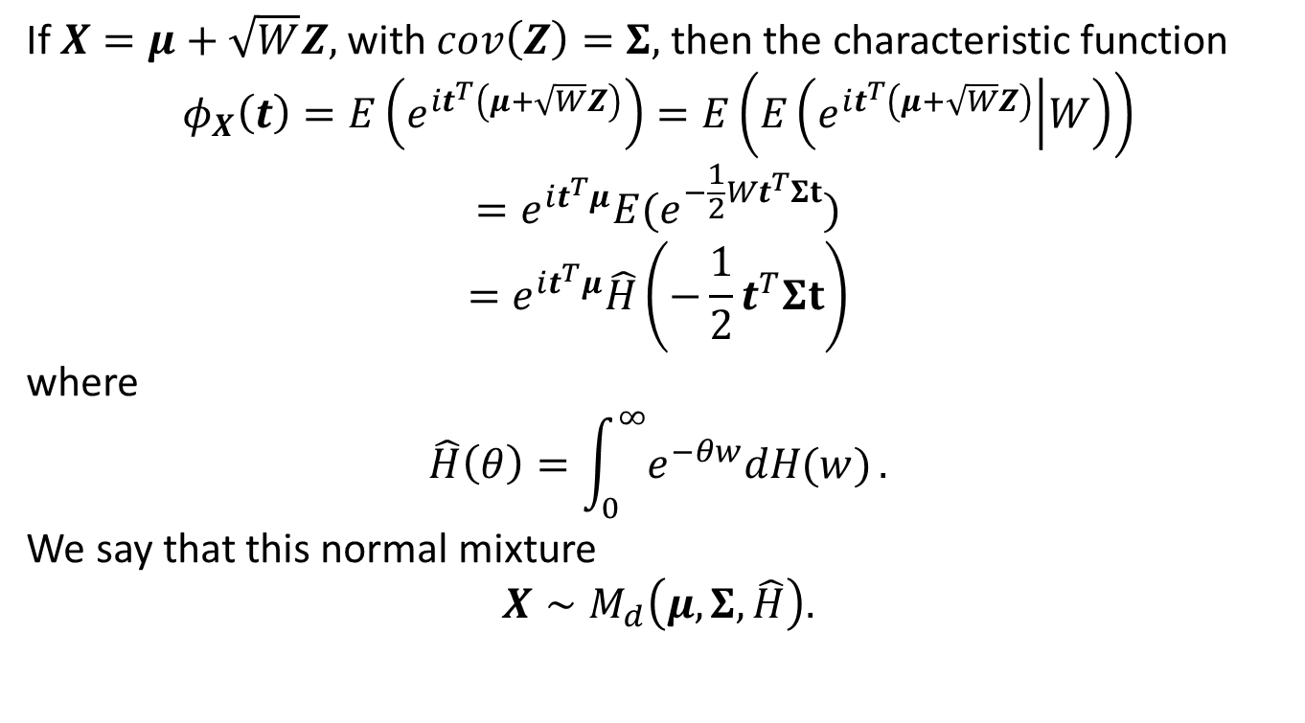
Normal Mixture Characteristic Function
If $X=μ+\sqrt{W}Z,$ with $cov\left(Z\right)=Σ,$ then the characteristic function
$$φ_{X}\left(t\right)=E\left(e^{it^{T}\left(μ+\sqrt{W}Z\right)}\right)=E\left(E\left(e^{it^{T}\left(μ+\sqrt{W}Z\right)} | W\right)\right)$$
$$=e^{it^{T}μ}E(e^{−\frac{1}{2}Wt^{T}Σt})$$
$$=e^{it^{T}μ}\hat{H}\left(−\frac{1}{2}t^{T}Σt\right)$$
where
$$\hat{H}\left(θ\right)=\int_{0}^{∞}{e^{−θw}dH(w)}.$$
We say that this normal mixture
$$X∼M_{d}\left(μ,Σ,\hat{H}\right).$$

Slide 33
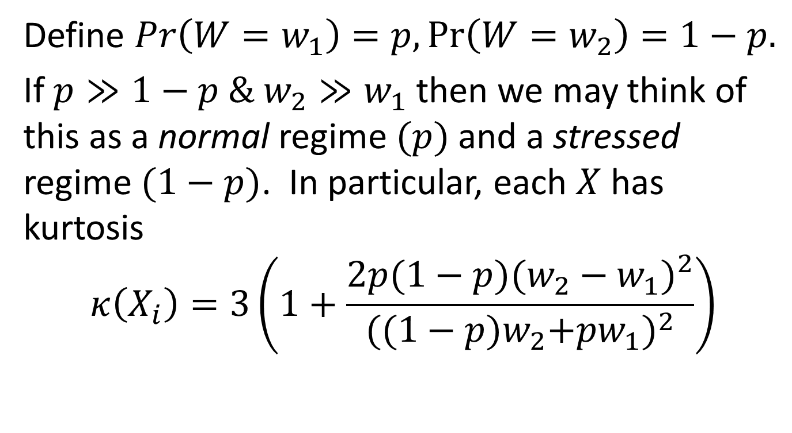
Another Example – Regime Switch
Define $Pr\left(W=w_{1}\right)=p,\operatorname{Pr}\left(W=w_{2}\right)=1−p.$
If $p≫1−p \& w_{2}≫w_{1}$ then we may think of this as a normal regime $(p)$ and a stressed regime $(1−p)$. In particular, each $X$ has kurtosis
$$κ\left(X_{i}\right)=3\left(1+\frac{2p(1−p){(w_{2}−w_{1})}^{2}}{{({(1−p)w}_{2}+pw_{1})}^{2}}\right)$$

Slide 34
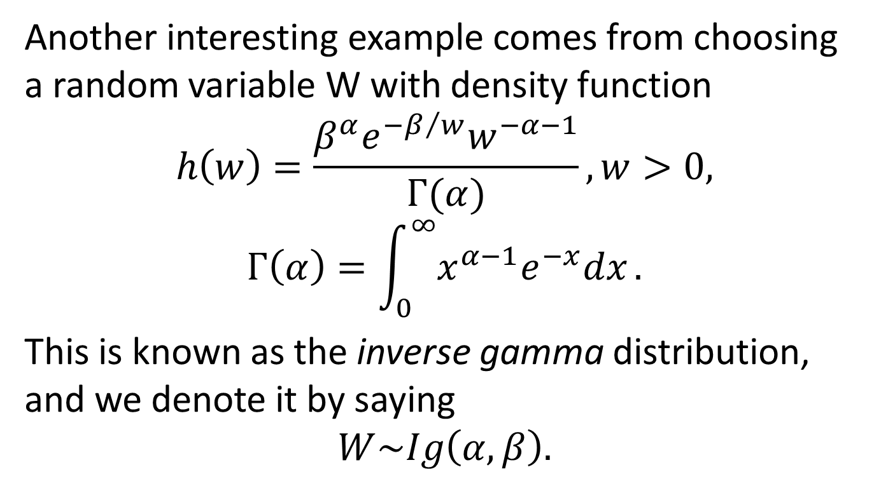
Inverse Gamma Distributions
Another interesting example comes from choosing a random variable W with density function
$$h\left(w\right)=\frac{β^{α}e^{−β/w}w^{−α−1}}{Γ(α)}, w>0,$$
$$Γ\left(α\right)=\int_{0}^{∞}{x^{α−1}e^{−x}dx}.$$
This is known as the inverse gamma distribution, and we denote it by saying
$$W\sim Ig\left(α,β\right).$$

Slide 35
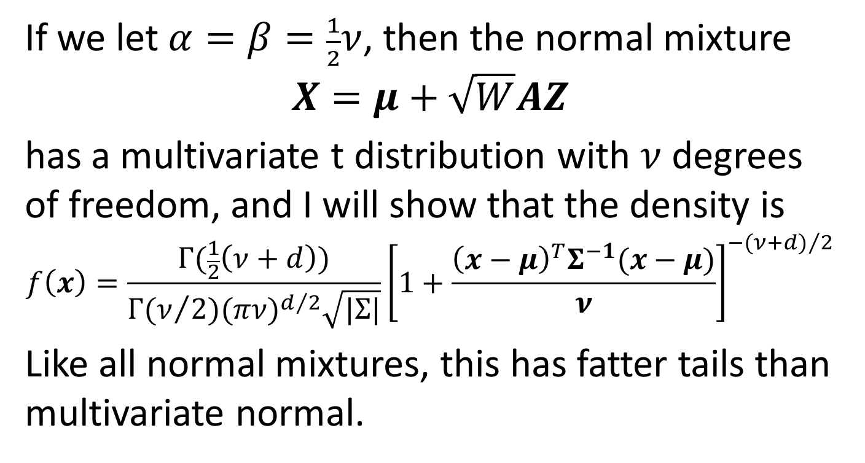
Multivariate t Distribution
If we let $α=β=\frac{1}{2}ν$, then the normal mixture
$$X=μ+\sqrt{W}AZ$$
has a multivariate t distribution with $ν$ degrees of freedom, and I will show that the density is
$$f\left(x\right)=\frac{Γ(\frac{1}{2}\left(ν+d\right))}{Γ(ν/2){(πν)}^{d/2}\sqrt{|Σ|}}{\left[1+\frac{{\left(x−μ\right)}^{T}Σ^{−1}(x−μ)}{ν}\right]}^{−{(ν+d)}/2}$$
Like all normal mixtures, this has fatter tails than multivariate normal.

Slide 36
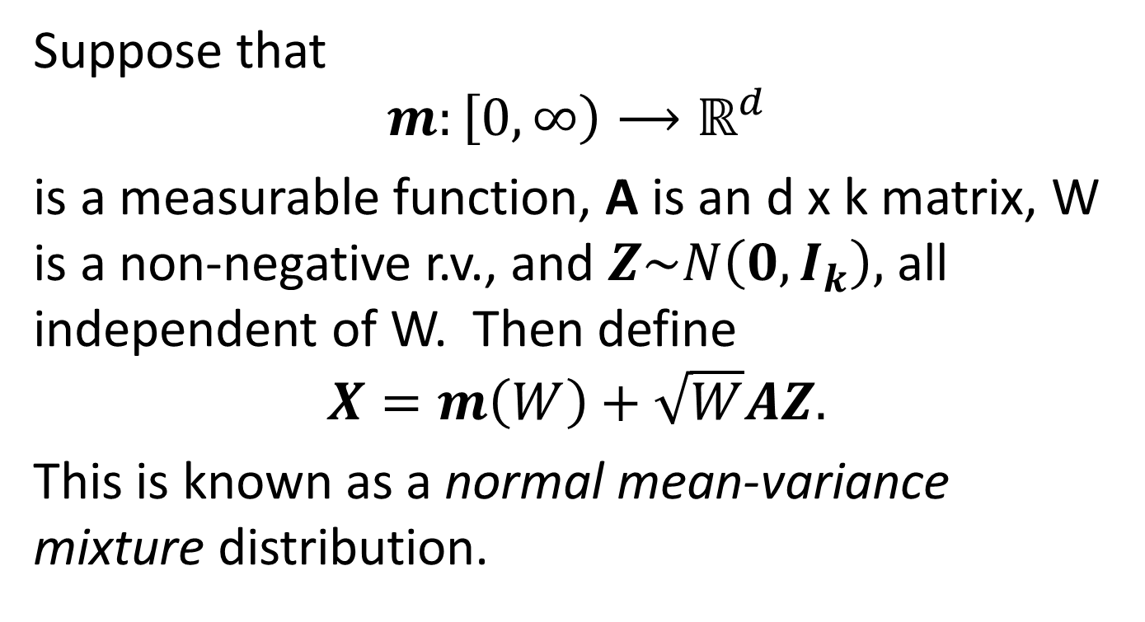
Normal Mean-Variance Mixture
Suppose that
$$m:\left[0,∞\right)⟶ℝ^{d}$$
is a measurable function, A is an d x k matrix, W is a non-negative r.v., and $Z\sim N\left(0,I_{k}\right),$ all independent of W. Then define
$$X=m\left(W\right)+\sqrt{W}AZ.$$
This is known as a normal mean-variance mixture distribution.

Slide 37
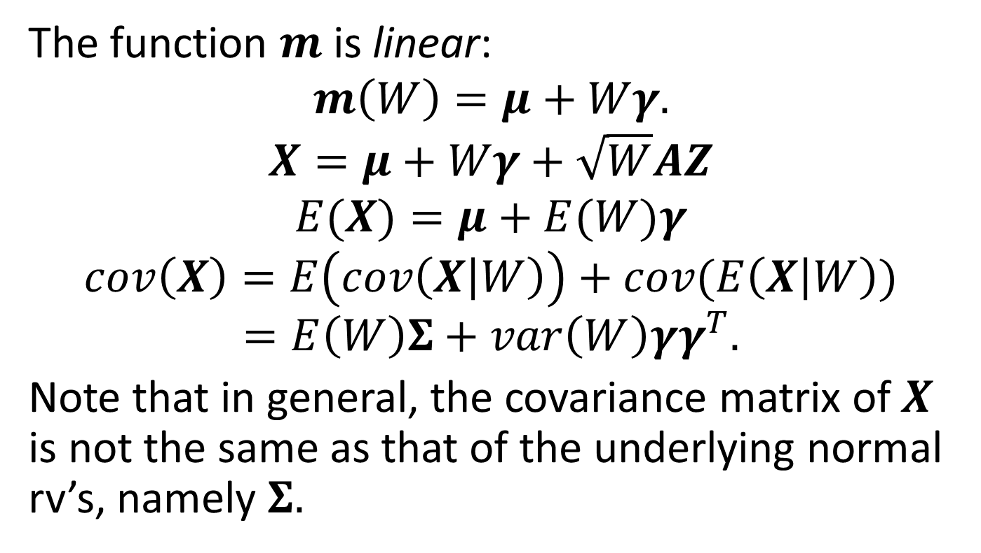
A Simple Example
The function $m$ is linear:
$$m\left(W\right)=μ+Wγ.$$
$$X=μ+Wγ+\sqrt{W}AZ$$
$$E(X)=μ+E(W)γ$$
$$cov\left(X\right)=E\left(cov\left(X | W\right)\right)+cov(E\left(X | W\right))$$
$$=E\left(W\right)Σ+var\left(W\right)γγ^{T}.$$
Note that in general, the covariance matrix of $X$ is not the same as that of the underlying normal rv’s, namely $Σ.$

Slide 38
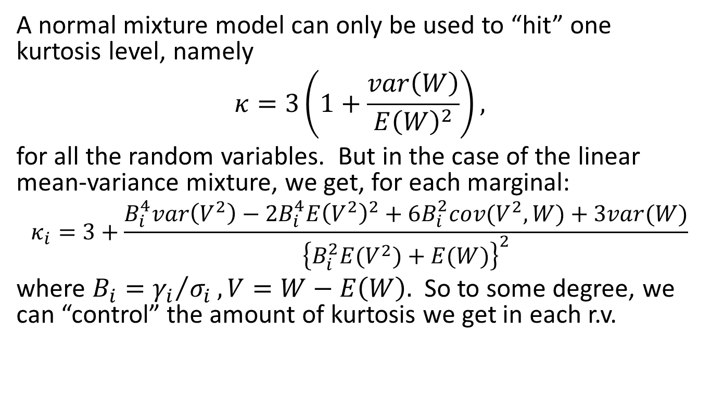
How to Realize n Different Kurtoses
A normal mixture model can only be used to “hit” one kurtosis level, namely
$$κ=3\left(1+\frac{var\left(W\right)}{E{\left(W\right)}^{2}}\right),$$
for all the random variables. But in the case of the linear mean-variance mixture, we get, for each marginal:
$$κ_{i}=3+\frac{B_{i}^{4}var\left(V^{2}\right)−2B_{i}^{4}E{\left(V^{2}\right)}^{2}+6B_{i}^{2}cov(V^{2},W)+3var(W)}{{\left\{B_{i}^{2}E(V^{2})+E(W)\right\}}^{2}}$$
where $B_{i}={γ_{i}}/{σ_{i}}, V=W−E\left(W\right).$ So to some degree, we can “control” the amount of kurtosis we get in each r.v.

Slide 39
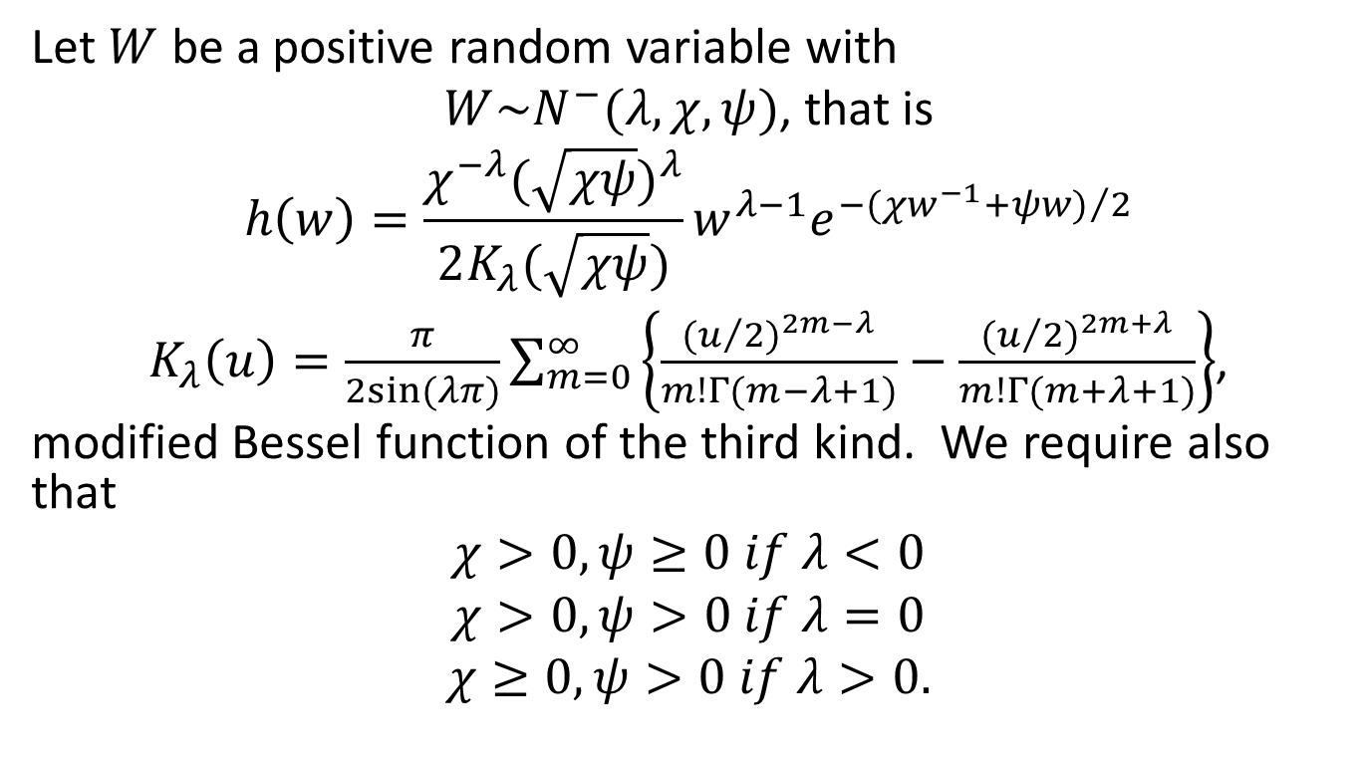
Generalized Inverse Gaussian
Let $W$ be a positive random variable with
$W\sim N^{−}(λ,χ,ψ)$, that is
$$h\left(w\right)=\frac{χ^{−λ}{(\sqrt{χψ})}^{λ}}{2K_{λ}(\sqrt{χψ})}w^{λ−1}e^{−{(χw^{−1}+ψw)}/2}$$
$K_{λ}\left(u\right)=\frac{π}{2sin⁡(λπ)}\sum_{m=0}^{∞}{\left\{\frac{{(u/2)}^{2m−λ}}{m!Γ(m−λ+1)}−\frac{{(u/2)}^{2m+λ}}{m!Γ(m+λ+1)}\right\}}$,
modified Bessel function of the third kind. We require also that
$$χ>0,ψ≥0 if λ<0$$
$$χ>0,ψ>0 if λ=0$$
$$χ≥0,ψ>0 if λ>0.$$

Slide 40
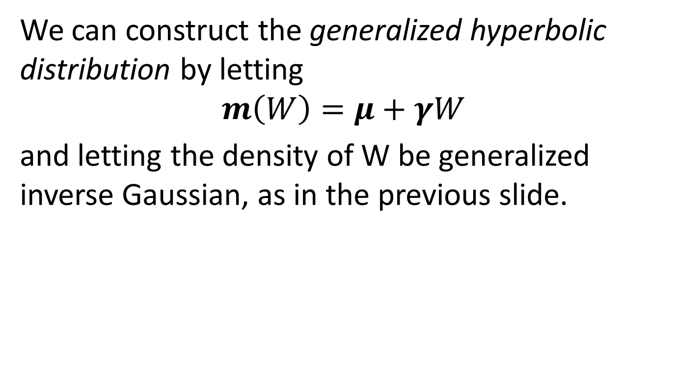
A Particular Mean Variance Mixture Example
We can construct the generalized hyperbolic distribution by letting
$$m\left(W\right)=μ+γW$$
and letting the density of W be generalized inverse Gaussian, as in the previous slide.

Slide 41
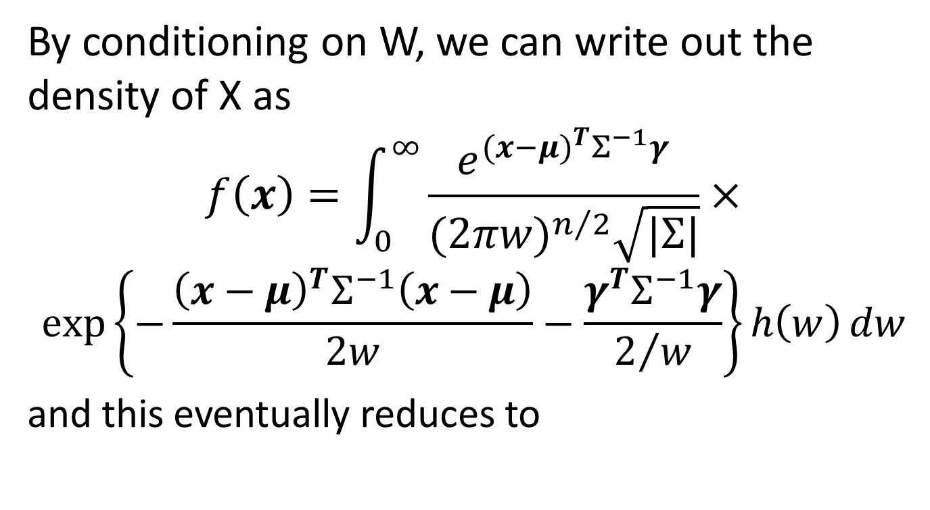
Generalized Hyperbolic Distribution, Cont’d
By conditioning on W, we can write out the density of X as
$$f\left(x\right)=\int_{0}^{∞}{\frac{e^{{(x−μ)}^{T}Σ^{−1}γ}}{{(2πw)}^{n/2}\sqrt{|Σ|}}}×$$
$$\exp\left\{−\frac{{\left(x−μ\right)}^{T}Σ^{−1}\left(x−μ\right)}{2w}−\frac{γ^{T}Σ^{−1}γ}{2/w}\right\}h\left(w\right)dw$$
and this eventually reduces to

Slide 42
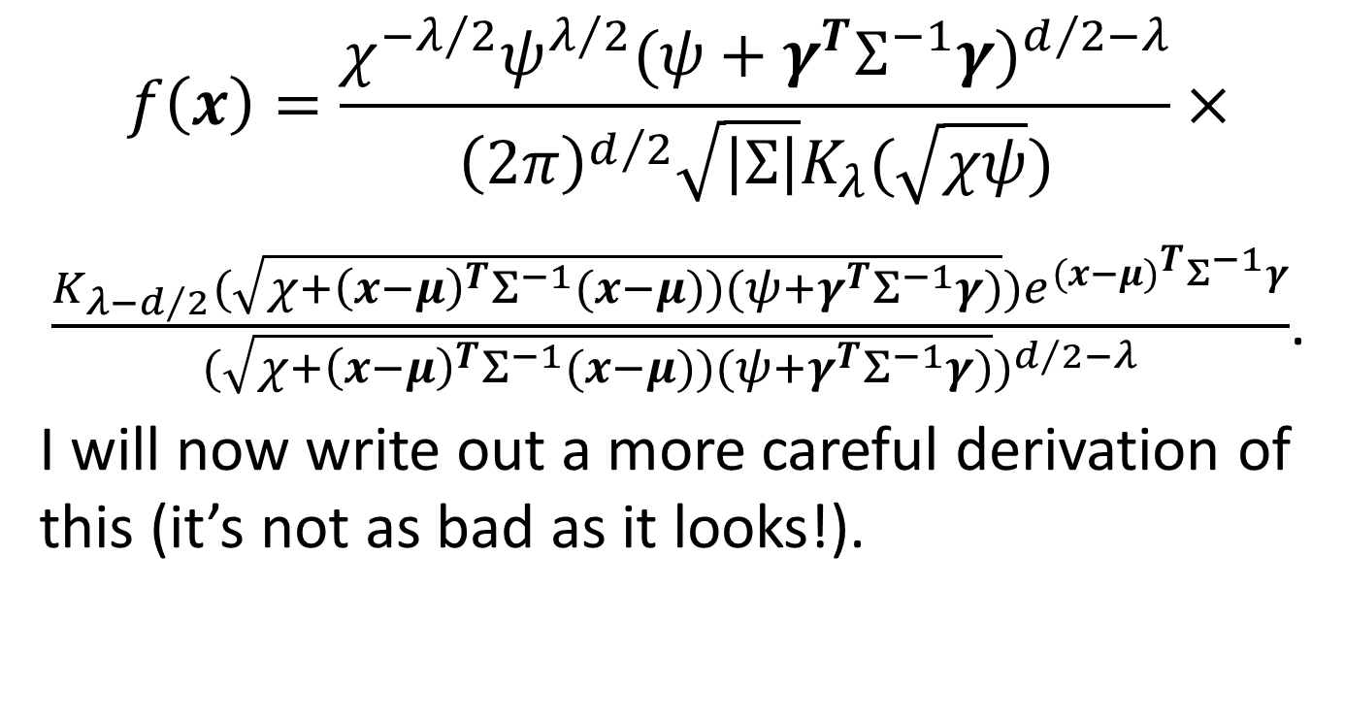
Generalized Hyperbolic Distribution, Cont’d
$$f\left(x\right)=\frac{χ^{−λ/2}ψ^{λ/2}{(ψ+γ^{T}Σ^{−1}γ)}^{d/2−λ}}{{\left(2π\right)}^{d/2}\sqrt{\left|Σ\right|}K_{λ}(\sqrt{χψ})}×$$
$\frac{K_{λ−d/2}(\sqrt{χ+{\left(x−μ\right)}^{T}Σ^{−1}(x−μ))(ψ+γ^{T}Σ^{−1}γ)})e^{{(x−μ)}^{T}Σ^{−1}γ}}{{(\sqrt{χ+{\left(x−μ\right)}^{T}Σ^{−1}(x−μ))(ψ+γ^{T}Σ^{−1}γ)})}^{d/2−λ}}$.
I will now write out a more careful derivation of this (it’s not as bad as it looks!).

Slide 43
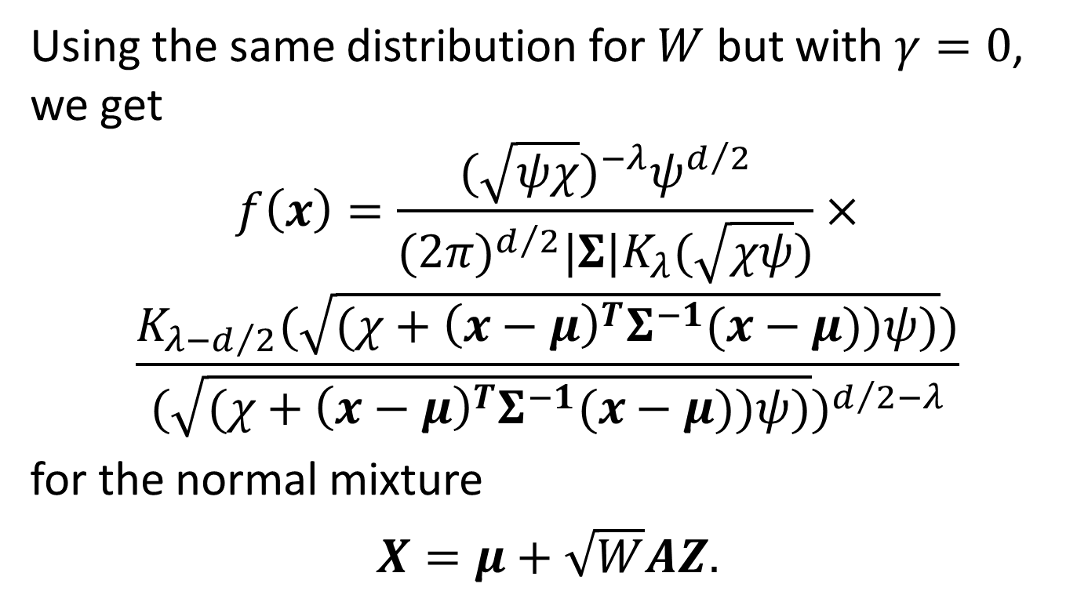
Symmetric Generalized Hyperbolic Distribution
Using the same distribution for $W$ but with $γ=0$, we get
$$f\left(x\right)=\frac{{(\sqrt{ψχ})}^{−λ}ψ^{d/2}}{{(2π)}^{d/2}|Σ|K_{λ}(\sqrt{χψ})}×$$
$$\frac{K_{λ−d/2}(\sqrt{(χ+{\left(x−μ\right)}^{T}Σ^{−1}(x−μ))ψ)})}{{(\sqrt{(χ+{\left(x−μ\right)}^{T}Σ^{−1}(x−μ))ψ)})}^{d/2−λ}}$$
for the normal mixture
$X=μ+\sqrt{W}AZ.$

Slide 44
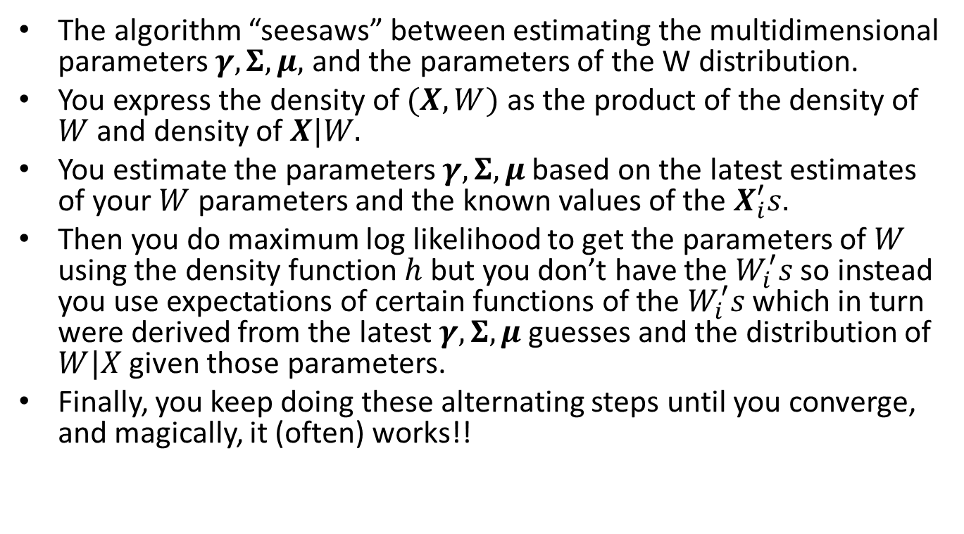
The EM Fitting Algorithm – The Basic Ideas
The algorithm “seesaws” between estimating the multidimensional parameters $γ,Σ,μ,$ and the parameters of the W distribution.
You express the density of $(X,W)$ as the product of the density of $W$ and density of $X|W.$
You estimate the parameters $γ,Σ,μ$ based on the latest estimates of your $W$ parameters and the known values of the $X_{i}^{′}s.$
Then you do maximum log likelihood to get the parameters of $W$ using the density function $h$ but you don’t have the $W_{i}^{′}s$ so instead you use expectations of certain functions of the $W_{i}^{′}s$ which in turn were derived from the latest $γ,Σ,μ$ guesses and the distribution of $W|X$ given those parameters.
Finally, you keep doing these alternating steps until you converge, and magically, it (often) works!!

Slide 45
EM Algorithm, cont’d
This algorithm can be used for any normal mean-variance mixture with any parametric distribution of non-negative r.v. W.
You didn’t think that last slide was going to be your entire introduction to this crucial algorithm, did you?? OF COURSE NOT!!! (Gory details to follow!)

Slide 46
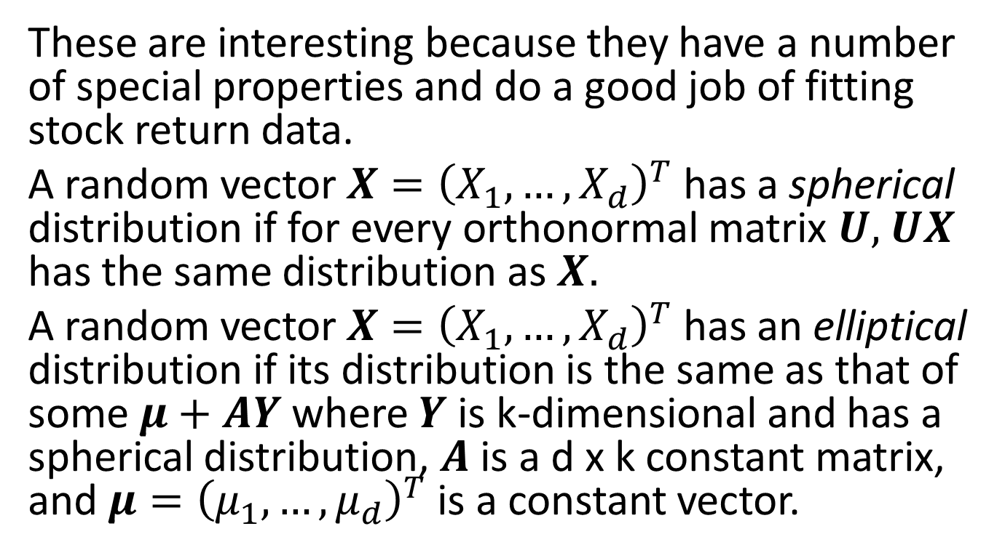
Spherical and Elliptical Distributions
These are interesting because they have a number of special properties and do a good job of fitting stock return data.
A random vector $X={\left(X_{1},…,X_{d}\right)}^{T}$ has a spherical distribution if for every orthonormal matrix $U,$ $UX$ has the same distribution as $X.$
A random vector $X={\left(X_{1},…,X_{d}\right)}^{T}$ has an elliptical distribution if its distribution is the same as that of some $μ+AY$ where $Y$ is k-dimensional and has a spherical distribution, $A$ is a d x k constant matrix, and $μ={\left(μ_{1},…,μ_{d}\right)}^{T}$ is a constant vector.

Slide 47
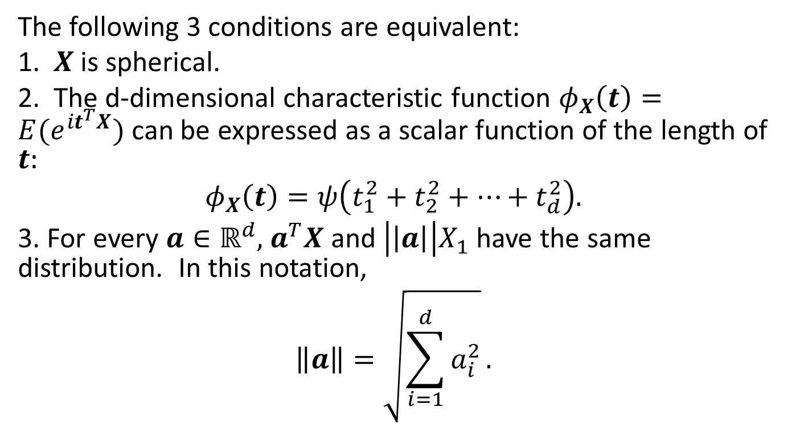
Properties of Spherical Distributions
The following 3 conditions are equivalent:
1. $X$ is spherical.
2. The d-dimensional characteristic function $φ_{X}\left(t\right)=E(e^{it^{T}X})$ can be expressed as a scalar function of the length of $t:$
$$φ_{X}\left(t\right)=ψ\left(t_{1}^{2}+t_{2}^{2}+…+t_{d}^{2}\right).$$
3. For every $a∈ℝ^{d},$ $a^{T}X$ and $\left|\left|a\right|\right|X_{1}$ have the same distribution. In this notation,
$$\left\|a\right\|=\sqrt{\sum_{i=1}^{d}{a_{i}^{2}}}.$$

Slide 48
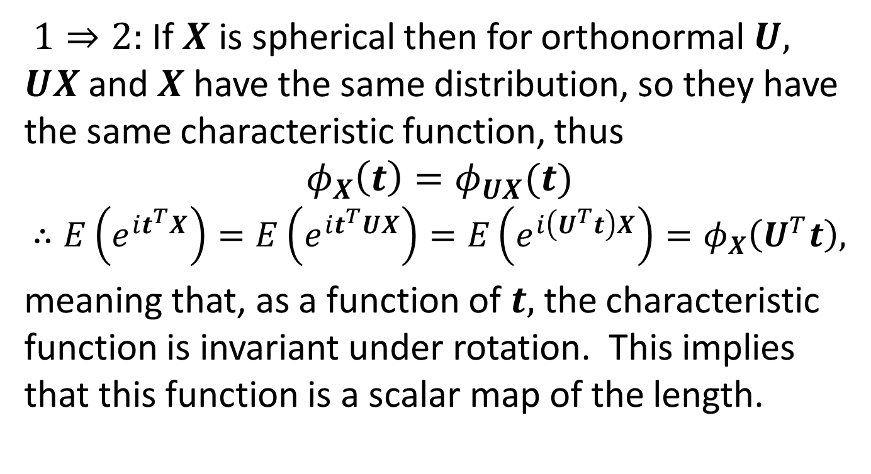
Properties of Spherical Distributions, cont’d
$1⇒2:$ If $X$ is spherical then for orthonormal $U,$ $UX$and $X$ have the same distribution, so they have the same characteristic function, thus
$$φ_{X}\left(t\right)=φ_{UX}(t)$$
$$∴E\left(e^{it^{T}X}\right)=E\left(e^{it^{T}UX}\right)=E\left(e^{i\left(U^{T}t\right)X}\right)=φ_{X}\left(U^{T}t\right),$$
meaning that, as a function of $t,$ the characteristic function is invariant under rotation. This implies that this function is a scalar map of the length.

Slide 49
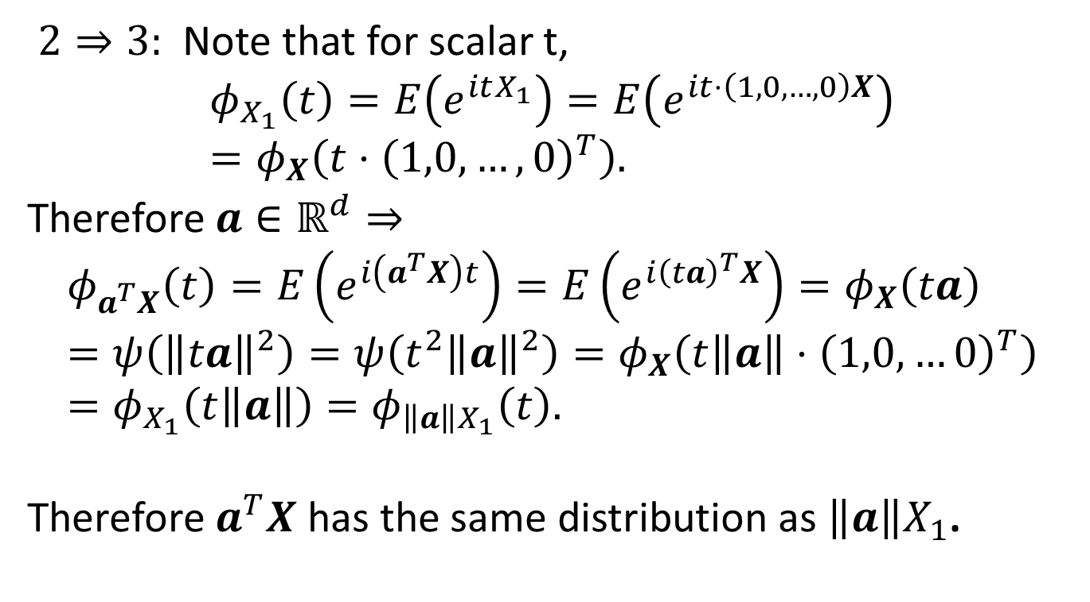
Properties of Spherical Distributions, cont’d
$2⇒3:$ Note that for scalar t,
$$φ_{X_{1}}\left(t\right)=E\left(e^{itX_{1}}\right)=E\left(e^{it⋅\left(1,0,…,0\right)X}\right)=φ_{X}\left(t⋅{\left(1,0,…,0\right)}^{T}\right).$$
Therefore $a∈ℝ^{d}⇒$
$$φ_{a^{T}X}\left(t\right)=E\left(e^{i\left(a^{T}X\right)t}\right)=E\left(e^{i{\left(ta\right)}^{T}X}\right)=φ_{X}\left(ta\right)=ψ\left({\left\|ta\right\|}^{2}\right)=ψ\left(t^{2}{\left\|a\right\|}^{2}\right)=φ_{X}\left(t\left\|a\right\|⋅{\left(1,0,…0\right)}^{T}\right)=φ_{X_{1}}\left(t\left\|a\right\|\right)=φ_{{\left\|a\right\|X}_{1}}\left(t\right).$$
Therefore $a^{T}X$ has the same distribution as ${\left\|a\right\|X}_{1}$.

Slide 50
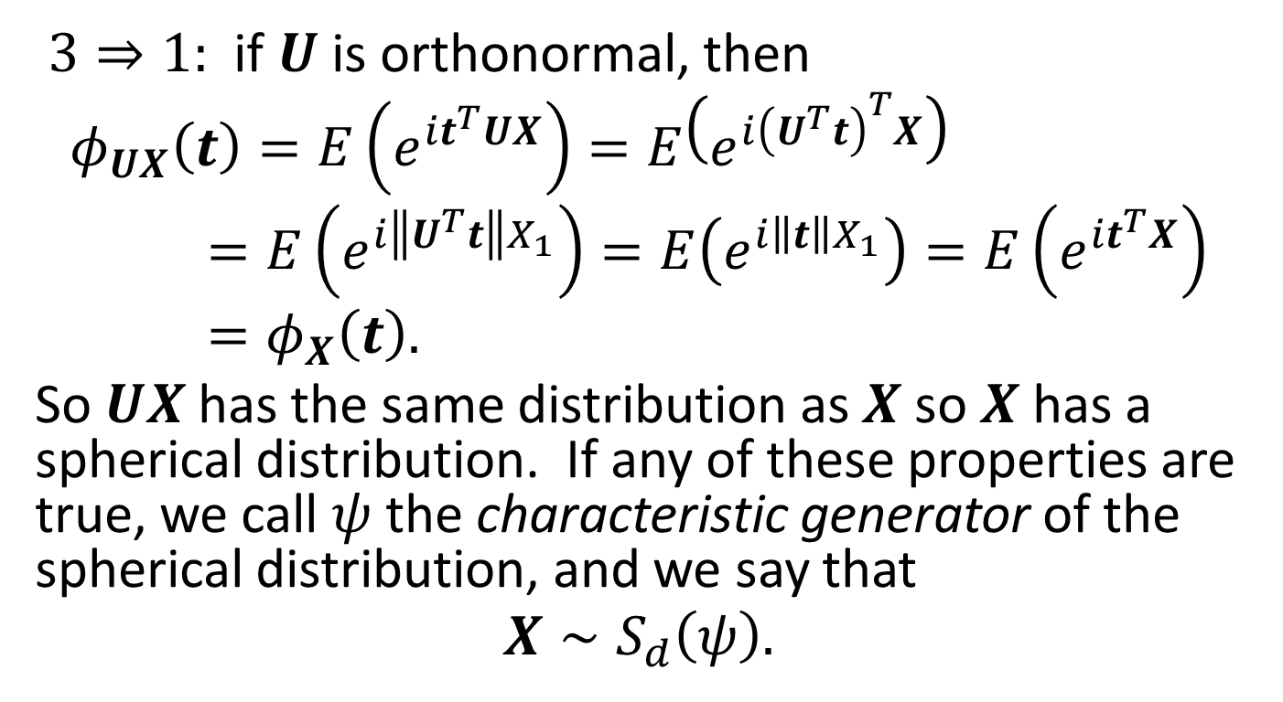
Properties of Spherical Distributions, cont’d
$3⇒1:$ if $U$ is orthonormal, then
$$φ_{UX}\left(t\right)=E\left(e^{it^{T}UX}\right)=E\left(e^{i{\left(U^{T}t\right)}^{T}X}\right)=E\left(e^{i\left\|U^{T}t\right\|X_{1}}\right)=E\left(e^{i\left\|t\right\|X_{1}}\right)=E\left(e^{it^{T}X}\right)=φ_{X}\left(t\right).$$
So $UX$has the same distribution as $X$ so $X$ has a spherical distribution. If any of these properties are true, we call $ψ$ the characteristic generator of the spherical distribution, and we say that
$$X∼S_{d}\left(ψ\right).$$

Slide 51
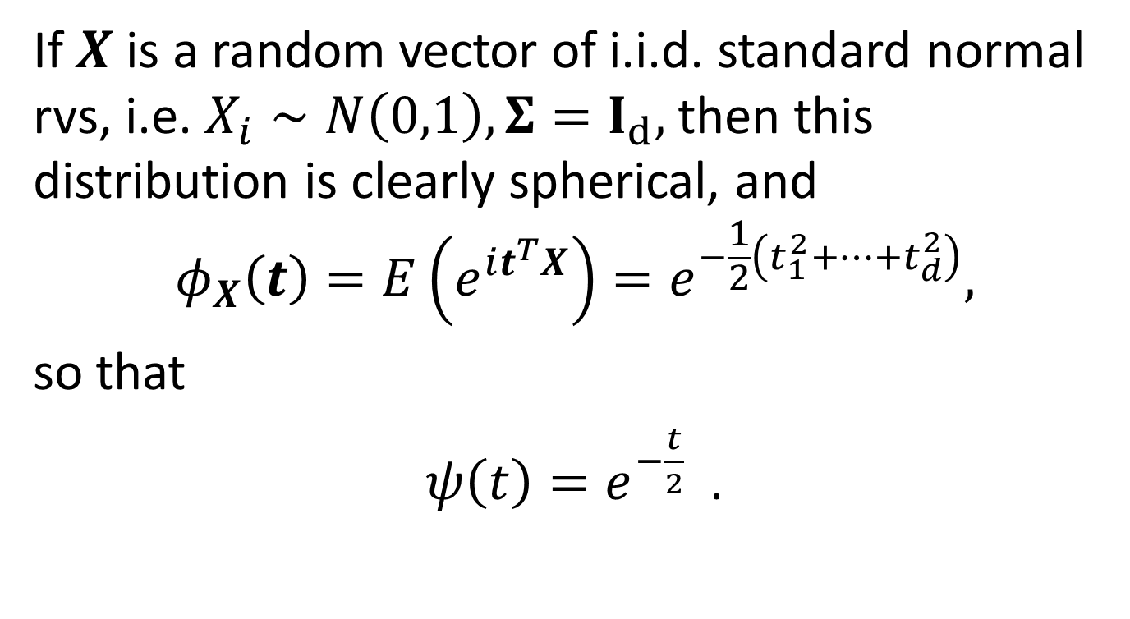
Example – Independent Normals
If $X$ is a random vector of i.i.d. standard normal rvs, i.e. $X_{i}∼N\left(0,1\right), Σ=I_{d},$ then this distribution is clearly spherical, and
$$φ_{X}\left(t\right)=E\left(e^{it^{T}X}\right)=e^{−\frac{1}{2}\left(t_{1}^{2}+…+t_{d}^{2}\right)},$$
so that
$ψ\left(t\right)=e^{−\frac{t}{2}}$ .

Slide 52
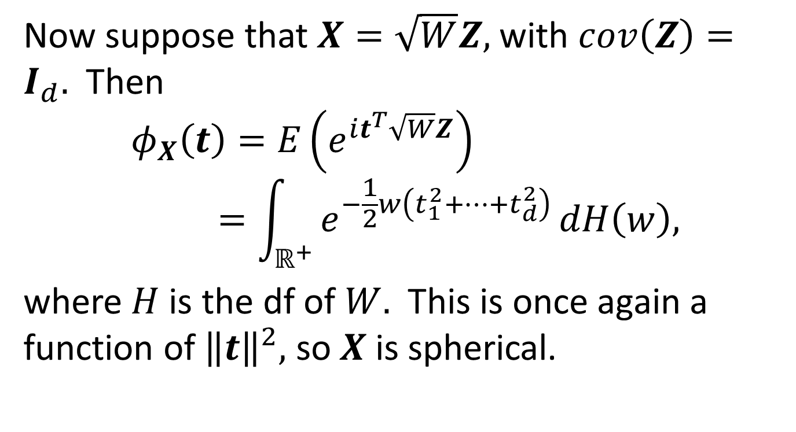
Example - Normal Mixture with Independent Normals
Now suppose that $X=\sqrt{W}Z,$ with $cov\left(Z\right)=I_{d}.$ Then
$$φ_{X}\left(t\right)=E\left(e^{it^{T}\sqrt{W}Z}\right)=\int_{ℝ^{+}}{e^{−\frac{1}{2}w\left(t_{1}^{2}+…+t_{d}^{2}\right)}}dH\left(w\right),$$
where $H$ is the df of $W.$ This is once again a function of ${\left\|t\right\|}^{2},$ so $X$is spherical.

Slide 53
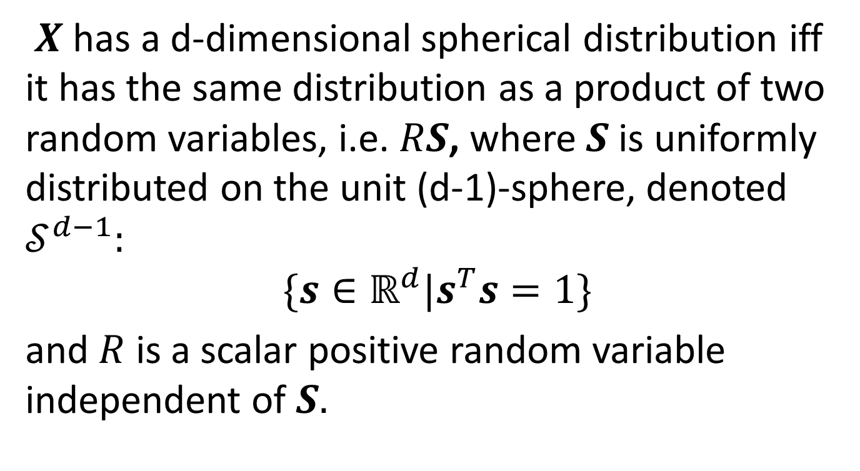
Another Cool Property of Spherical Distributions
$X$ has a d-dimensional spherical distribution iff it has the same distribution as a product of two random variables, i.e. $RS$, where $S$is uniformly distributed on the unit (d-1)-sphere, denoted $𝒮^{d−1}:$
$$\{s∈ℝ^{d}|s^{T}s=1\}$$
and $R$ is a scalar positive random variable independent of $S.$

Slide 54
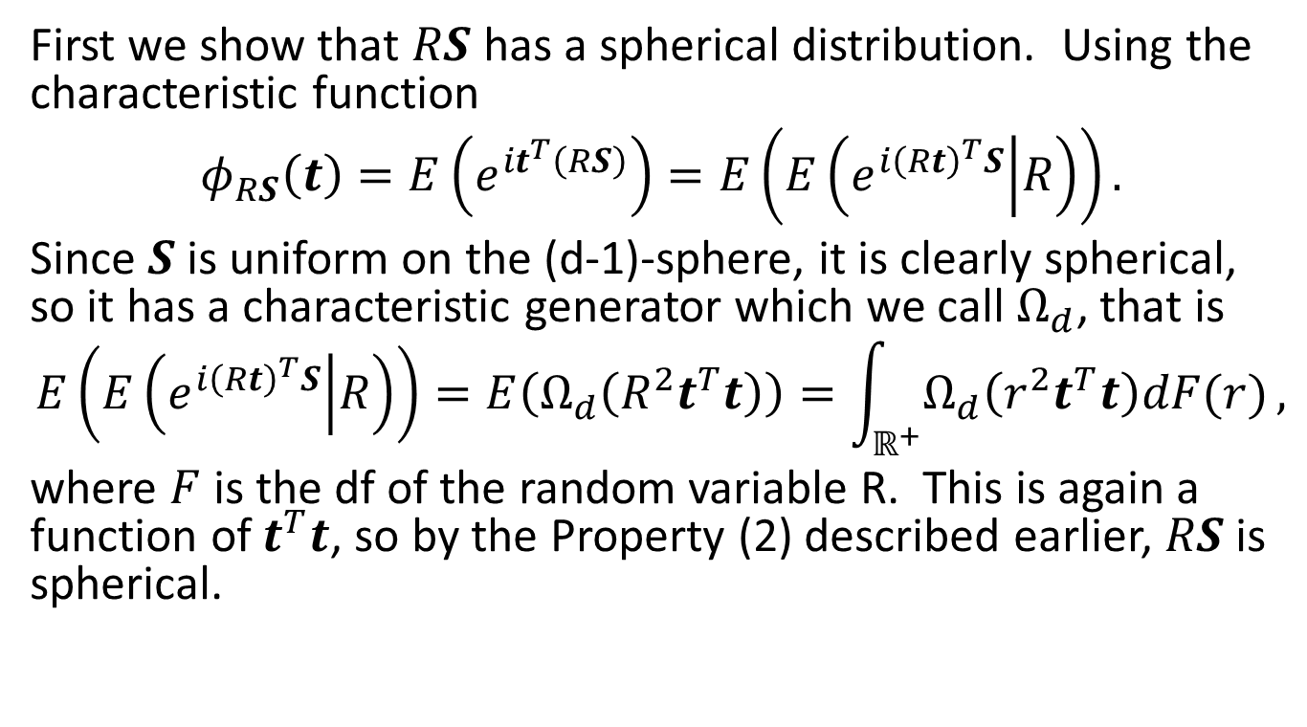
Decomposition of Spherical Distributions, cont’d
First we show that $RS$ has a spherical distribution. Using the characteristic function
$$φ_{RS}\left(t\right)=E\left(e^{it^{T}\left(RS\right)}\right)=E\left(E\left(e^{i{\left(Rt\right)}^{T}S} | R\right)\right).$$
Since $S$ is uniform on the (d-1)-sphere, it is clearly spherical, so it has a characteristic generator which we call $Ω_{d}$, that is
$$E\left(E\left(e^{i{\left(Rt\right)}^{T}S} | R\right)\right)=E\left(Ω_{d}\left(R^{2}t^{T}t\right)\right)=\int_{ℝ^{+}}{Ω_{d}\left(r^{2}t^{T}t\right)dF(r)},$$
where $F$ is the df of the random variable R. This is again a function of $t^{T}t$, so by the Property (2) described earlier, $RS$ is spherical.

Slide 55
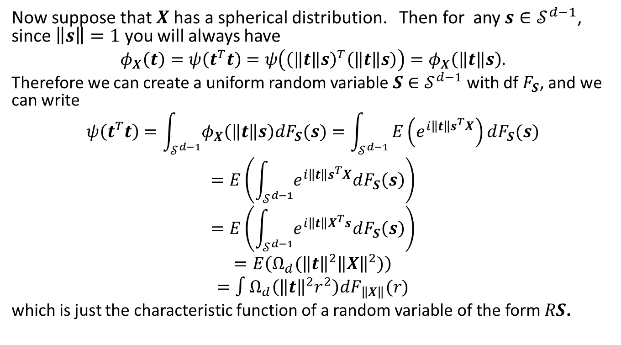
Decomposition of Spherical Distributions, cont’d
Now suppose that $X$has a spherical distribution. Then for any $s∈𝒮^{d−1}$, since $\left\|s\right\|=1$ you will always have
$$φ_{X}\left(t\right)=ψ\left(t^{T}t\right)=ψ\left({\left(\left\|t\right\|s\right)}^{T}\left(\left\|t\right\|s\right)\right)=φ_{X}\left(\left\|t\right\|s\right).$$
Therefore we can create a uniform random variable $S∈𝒮^{d−1}$ with df $F_{S}$, and we can write
$$ψ\left(t^{T}t\right)=\int_{𝒮^{d−1}}{φ_{X}\left(\left\|t\right\|s\right)dF_{S}(s)}=\int_{𝒮^{d−1}}{E\left(e^{i\left\|t\right\|s^{T}X}\right)dF_{S}(s)}$$
$$=E\left(\int_{𝒮^{d−1}}{e^{i\left\|t\right\|s^{T}X}dF_{S}\left(s\right)}\right)$$
$$=E\left(\int_{𝒮^{d−1}}{e^{i\left\|t\right\|X^{T}s}dF_{S}\left(s\right)}\right)$$
$$=E\left(Ω_{d}({\left\|t\right\|}^{2}{\left\|X\right\|}^{2})\right)$$
$$=∫Ω_{d}\left({\left\|t\right\|}^{2}r^{2}\right)dF_{\left\|X\right\|}(r)$$
which is just the characteristic function of a random variable of the form $RS$.

Slide 56
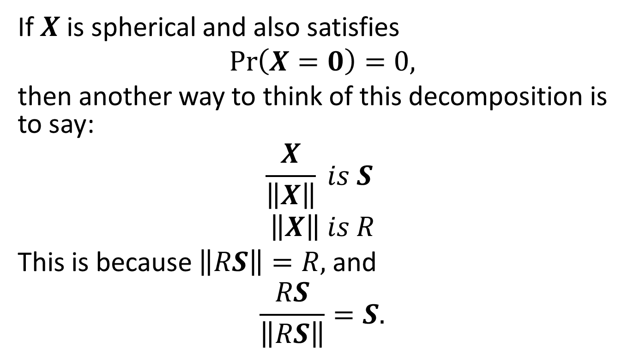
Decomposition of Spherical Distributions, cont’d
If $X$ is spherical and also satisfies
$\operatorname{Pr}\left(X=0\right)=0,$
then another way to think of this decomposition is to say:
$$\frac{X}{\left\|X\right\|} is S$$
$$\left\|X\right\| is R$$
This is because $\left\|RS\right\|=R,$ and
$$\frac{RS}{\left\|RS\right\|}=S.$$

Slide 57
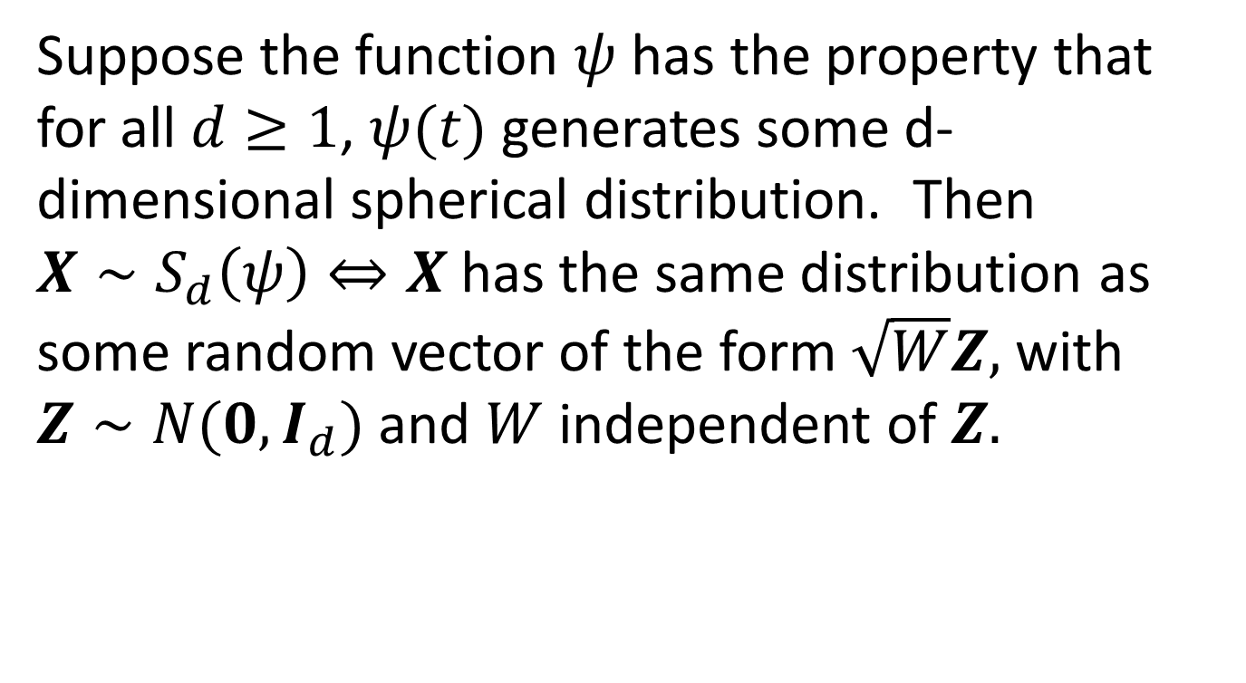
An Important Class of Spherical Distributions
Suppose the function $ψ$ has the property that for all $d≥1$, $ψ(t)$ generates some d-dimensional spherical distribution. Then $X∼S_{d}\left(ψ\right)⇔X$has the same distribution as some random vector of the form $\sqrt{W}Z,$ with $Z∼N(0,I_{d})$ and $W$ independent of $Z.$

Slide 58
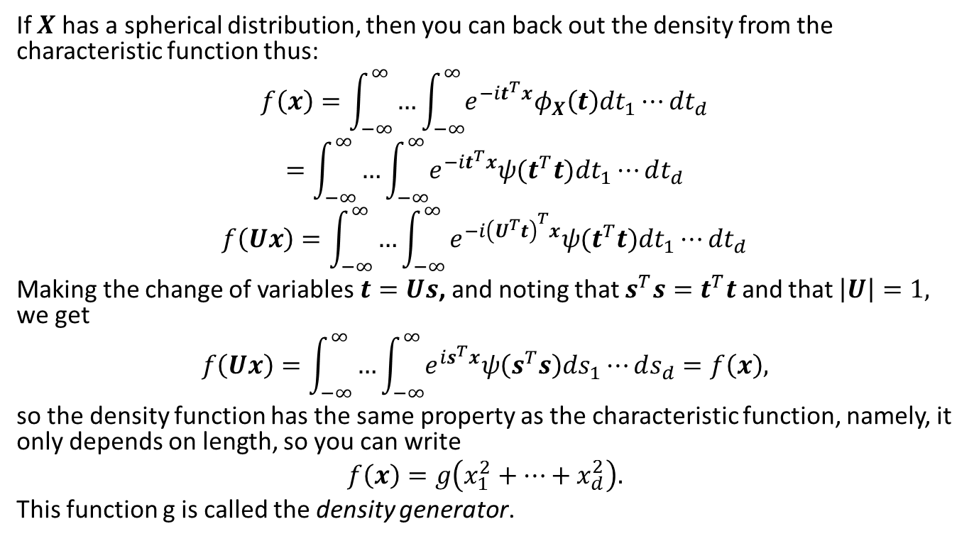
Density Generators of Spherical Distributions
If $X$ has a spherical distribution, then you can back out the density from the characteristic function thus:
$$f\left(x\right)=\int_{−∞}^{∞}{…\int_{−∞}^{∞}{e^{−it^{T}x}φ_{X}\left(t\right)dt_{1}⋯dt_{d}}}$$
$$=\int_{−∞}^{∞}{…\int_{−∞}^{∞}{e^{−it^{T}x}ψ(t^{T}t)dt_{1}⋯dt_{d}}}$$
$$f\left(Ux\right)=\int_{−∞}^{∞}{…\int_{−∞}^{∞}{e^{−i{\left(U^{T}t\right)}^{T}x}ψ(t^{T}t)dt_{1}⋯dt_{d}}}$$
Making the change of variables $t=Us$, and noting that $s^{T}s=t^{T}t$ and that $\left|U\right|=1,$ we get
$$f\left(Ux\right)=\int_{−∞}^{∞}{…\int_{−∞}^{∞}{e^{is^{T}x}ψ\left(s^{T}s\right)ds_{1}⋯ds_{d}}}=f\left(x\right),$$
so the density function has the same property as the characteristic function, namely, it only depends on length, so you can write
$$f\left(x\right)=g\left(x_{1}^{2}+⋯+x_{d}^{2}\right).$$
This function g is called the density generator.

Slide 59

Elliptical Distributions
Elliptical distributions are a much more general class of distributions of the form
$$X=μ+AY,$$
at least up to distribution, with $Y∼S_{k}\left(ψ\right),$ $A$ is a d x k matrix of constants, and $μ∈ℝ^{d}$. Given that
$φ_{X}\left(t\right)=E\left(e^{it^{T}X}\right)=E\left(e^{it^{T}(μ+AY)}\right)=e^{it^{T}μ}E\left(e^{i{\left(A^{T}t\right)}^{T}Y}\right)=e^{it^{T}μ}ψ\left({\left(A^{T}t\right)}^{T}\left(A^{T}t\right)\right)=e^{it^{T}μ}ψ\left(t^{T}AA^{T}t\right)=e^{it^{T}μ}ψ\left(t^{T}Σt\right)$,
we say that
$$X∼E_{d}\left(μ,Σ,ψ\right).$$
This representation is only unique up to a constant (for all such distributions, not just normals!), because you could replace $Σ$ by $cΣ$ and $ψ(t)$ by $ψ(t/c)$ and get the same answer.

Slide 60

Breakdown of Elliptical Distribution
$X∼E_{d}(μ,Σ,ψ)$ iff there exist $S, R, A$ satisfying
$$X=μ+RAS$$
(in distribution) with
$S$ uniformly distributed on $𝒮^{k−1}$
$R≥0$ is a radial r.v. independent of $S$
$A∈ℝ^{d ×k},$ with $AA^{T}=Σ$
In the case where $Σ$ is positive definite you can write
$$Σ^{−1/2}\left(X−μ\right)∼S_{d}(ψ)$$

Slide 61

Breakdown of Elliptical Distributions, cont’d
We note that
$$\left\|Σ^{−1/2}(X−μ)\right\|=\sqrt{{\left(X−μ\right)}^{T}Σ^{−1}\left(X−μ\right)}$$
so if $Σ^{−1/2}\left(X−μ\right)∼S_{d}(ψ)$, then $\sqrt{{\left(X−μ\right)}^{T}Σ^{−1}\left(X−μ\right)}$ is our radial r.v. R, and $\frac{Σ^{−1/2}\left(X−μ\right)}{\sqrt{{\left(X−μ\right)}^{T}Σ^{−1}\left(X−μ\right)}}$ is our uniform random variable S defined on $𝒮^{d−1}.$
Note that all normal variance mixtures are elliptical.

Slide 62

Testing for Elliptical Symmetry
Suppose that $X∼E_{d}\left(μ,Σ,ψ\right),$ and suppose that for some $c,$ $\operatorname{Pr}\left({\left(X−μ\right)}^{T}Σ^{−1}\left(X−μ\right)≥c\right)>0$. Then the conditional correlation matrix
$$ρ\left(X | {\left(X−μ\right)}^{T}Σ^{−1}\left(X−μ\right)≥c\right)=ρ\left(X\right).$$
But $X|{\left(X−μ\right)}^{T}Σ\left(X−μ\right)≥c$ has the same distribution as $μ+RAS|R^{2}>c.$ But if we label $\tilde{R}=R|R^{2}>c,$ then we are looking at a distribution of the form $μ+\tilde{R}AS$, which has the same dispersion matrix as $μ+RAS$, and thus the same correlation matrix.

Slide 63

Other Properties of Elliptical Distributions
If $X∼E_{d}\left(μ,Σ,ψ\right),$then for $B∈ℝ^{k×d}, b∈ℝ^{k},$ $BX+b∼E_{k}\left(Bμ+b,BΣB^{T},ψ\right).$ In other words, linear mappings of elliptical random vectors are elliptical.
Marginal distributions of elliptical random vectors are elliptical with the same $ψ.$
The distribution of $\left(X_{1},…,X_{k}\right)$conditioned on $(X_{k+1},…,X_{d})$ is also elliptical, but the $ψ$ function might be different.
The sum of two independent elliptical random vectors with the same $Σ$ (dispersion matrix) is elliptical, but the new $ψ$ is the product of the two input $ψ^{′}s.$

Slide 64

Fitting an Elliptical Distribution
We assume that we have n samples of a d-vector $X_{1},X_{2},…,X_{n}.$ Now…
Let ${\hat{μ}}^{\left[1\right]}=\overline{X}, {\hat{Σ}}^{\left[1\right]}=S,$ the sample mean and covariance matrix. The bracketed subscript is the iteration.
For each $X_{i},$ let
$$D_{i}^{2}={\left(X_{i}−{\hat{μ}}^{\left[k\right]}\right)}^{T}{\left({\hat{Σ}}^{\left[k\right]}\right)}^{−1}\left(X_{i}−{\hat{μ}}^{\left[k\right]}\right)$$

Slide 65

Fitting an Elliptical Distribution, cont’d
3. Update the mean by setting ${\hat{μ}}^{\left[k+1\right]}=\frac{\sum_{i=1}^{n}{w_{1}\left(D_{i}\right)X_{i}}}{\sum_{i=1}^{n}{w_{1}\left(D_{i}\right)}},$ where $w_{1}$ is a decreasing, positive weight function.
4. Update the dispersion matrix by setting ${\hat{Σ}}^{\left[k+1\right]}=\frac{\sum_{i=1}^{n}{w_{2}\left(D_{i}^{2}\right)\left(X_{i}−{\hat{μ}}^{\left[k\right]}\right){\left(X_{i}−{\hat{μ}}^{\left[k\right]}\right)}^{T}}}{\sum_{i=1}^{n}{w_{2}\left(D_{i}^{2}\right)}},$where $w_{2}$ is another decreasing, positive weight function. For the weight functions you might try $w_{1}\left(x\right)=w_{2}\left(x\right)=1$ for $x<a$ and $a/x$ for $x≥a.$ Note that MFE has n in the denominator (I think that is wrong!).
5. Replace $k$ by $k+1$, and do (2) to (4) until the mean and covariance converges.

Slide 66

Dimension Reduction and Factor Models
The random vector X follows a factor model if you can write it as
$$X=a+BF+ε,$$
$$a={(a_{1},…,a_{d})}^{T}, constants$$
$$F={\left(F_{1},…,F_{k}\right)}^{T}, k<d$$
$$cov\left(F\right) non−singular$$
$$B is d×k, constant$$
$$ε={(ε_{1},…,ε_{d})}^{T}, cov\left(ε_{i},ε_{j}\right)=cov\left(ε_{i},F_{l}\right)=0$$

Slide 67

Factor Model, Cont’d
The covariance matrix can be written as
$$Σ=cov\left(X\right)=BΩB^{T}+Λ$$
$$Ω=cov(F)$$
$$Λ is diagonal.$$
Now let
$$F^{∗}=Ω^{−1/2}(F−E\left(F\right))$$
$$B^{∗}=BΩ^{1/2}$$
$$μ=a+BE\left(F\right).$$
Then
$$X=μ+B^{∗}F^{∗}+ε$$
$$Σ=B^{∗}{(B^{∗})}^{T}+Λ$$

Slide 68

Factor Models, Cont’d
The converse is true: If we can write the covariance matrix as
$$cov\left(X\right)=BB^{T}+Λ$$
with B being d x k and $Λ$ diagonal, then X is a factor model of the form
$$X=μ+BF+ε$$
as defined above.

Slide 69

A Simple (and Very Popular) Factor Model
Suppose that X has the property that
$$var\left(X_{i}\right)=1$$
$$E\left(X_{i}\right)=0$$
$$cov\left(X_{i},X_{j}\right)=ρ, i≠j$$
Then we pick any r.v. Y with E(Y)=0 and var(Y)=1, independent of X, and find a single factor F, defined as
$$F=\frac{\sqrt{ρ}}{1+ρ(d−1)}\sum_{i=1}^{d}{X_{i}}+\sqrt{\frac{1−ρ}{1+ρ(d−1)}}Y$$
$$ε_{i}=X_{i}−\sqrt{ρ}F$$
$⟹X=BF+ε$,
$$B={(\sqrt{ρ},…,\sqrt{ρ})}^{T}$$
This sort of model is used when regressing stock returns vs that of a single index.

Slide 70

Stocks vs Index
It is common to regard returns of an index, such as SPX, as a common factor driving most stock market returns. Let $F_{t}$ be the daily return on the index, and for the jth stock, let $X_{t,j}$ be its daily return. Then for each j, we run the least-squares regression
$$X_{i,j}=α_{j}+β_{j}F_{t}+ε_{t,j}.$$
The regression guarantees that the sample covariance of the errors and the index factor will be 0. Note that the $β_{j}$ coefficient is the infamous “beta” you hear about when people compare the movements of a stock to those of the S&P.

Slide 71

Principal Components
When doing Monte Carlo, we will often improve efficiency by reducing the number of underlying variables we have to simulate. We can do this using principal component analysis (PCA).
Suppose we have n random variables $X_{1},…,X_{n}$ with covariance matrix $Σ$. By spectral decomposition, there is a matrix C such that
$$Σ=CΛC^{T}$$
$$CC^{T}=I,$$
and $Λ$ is a diagonal matrix with diagonal elements
$$λ_{1}≥λ_{2}≥…≥λ_{n}≥0.$$

Slide 72

Principal Components, Cont’d
The rows of C are the eigenvectors of $Σ$.
And of the means of the vector $X$ make up the vector $μ$, then the vector of random variables
$$\left(X−μ\right)C=Y$$
are all uncorrelated and have variances
$$var\left(Y_{i}\right)=λ_{i}.$$
The idea of principal components is to choose a small number k < n, such that the first k Y’s account for most of the variability.

Slide 73

Principal Components, Cont’d
The criterion is that
$\frac{\sum_{i=1}^{k}{λ_{i}}}{\sum_{i=1}^{n}{λ_{i}}}>0.95$,
or some other high percentage. We say in this case that the first k principal components account for more than 95% of the variability. Hence we may decide to throw the rest away (next slide).

Slide 74
Principal Components, Cont’d
Let $\tilde{Λ}$ be a diagonal matrix with diagonal elements ${\tilde{λ}}_{1},…{\tilde{λ}}_{n}$ such that
$${\tilde{λ}}_{i}=λ_{i}, i≤k,$$
$${\tilde{λ}}_{i}=0, i>k.$$
Next, we want
$$\left(\tilde{X}−μ\right)C=\tilde{Y}=(Y_{1},…,Y_{k},0,…,0)$$
$$\tilde{X}=\tilde{Y}C^{T}+μ.$$
This allows us to simulate k uncorrelated random variables instead of all n. It’s common for n to be hundreds while k is 3 or 4.

Slide 75
Monte Carlo Example – VaR Model for Equities Using 10 Years’ Data
For each name, compute the 1-year historical vol and 10 year kurtosis. We want variance to reflect more recent data.
Create a random variable with that volatility and kurtosis
Use principal component analysis to correlate all the different names’ random variables.
Simulate 500,000 times for each name
Add all the P&Ls over all the positions, sort and take Number 5000 as the value at risk. Average these 5000 to get the expected shortfall.

Slide 76

Normal Mixture Example for VaR
There are N stock indices, and each index has a return of the form
$$r_{i}=\sqrt{W}\left(a_{i,1}Z_{1}+a_{i,2}Z_{2}+…+a_{i,M}Z_{M}\right)$$
$Z_{j}\sim N\left(0,1\right)$, all independent
$E\left(W\right)=1, E\left(W^{2}\right)>1,$ independent from Z’s
$$κ\left(r_{i}\right)=3(E\left(W^{2}\right))$$
The Z’s represent the principal components of the market.

Slide 77

Individual Stock Treatment
$$r_{s}=br_{I}+σ_{s}\sqrt{W_{s}}Z_{s}$$
$$W,Z, r_{I} all independent$$
Let $σ_{I}^{2}=var\left(r_{I}\right)$
Then $var\left(r_{s}\right)=bσ_{I}^{2}+σ_{s}^{2}$
$$Kurt\left(r_{s}\right)=3\frac{b^{4}σ_{I}^{4}\left(E\left(W_{I}^{2}\right)−1\right)+σ_{s}^{4}\left(E\left(W_{s}^{2}\right)−1\right)}{b^{4}σ_{I}^{4}+2b^{2}σ_{I}^{2}σ_{s}^{2}+σ_{s}^{4}}$$

